Slide 1
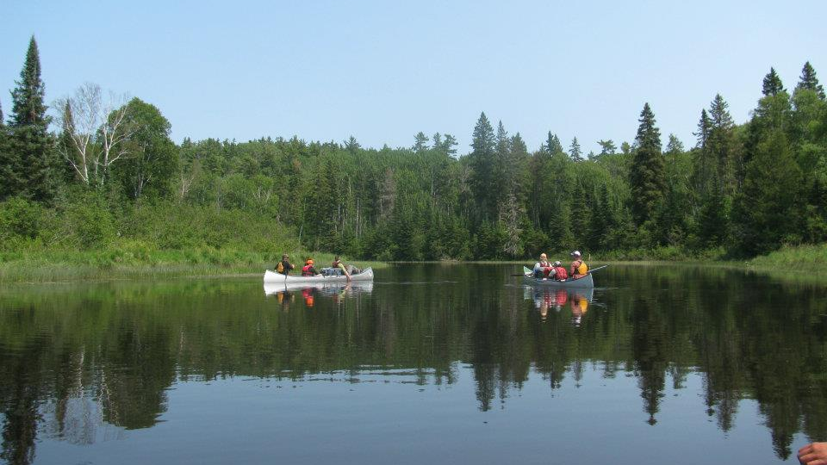
Northern Lakes Girl Scout Canoe Base
Paddle with us on the adventure of a lifetime!

Slide 2
Notes:
The Northern Lakes Girl Scout Canoe Base is the premier location for girls (12 and up) to explore the Boundary Waters Canoe Area Wilderness (BWCAW) and has provided Girl Scout canoe trips since the 1960s. The base is operated through the Girl Scouts Lakes and Pines Council on land leased from the US Forest Service at the edge of the Boundary Waters Canoe Area Wilderness.
The Northern Lakes Canoe Base Alumni Association is a network of former staff, participants and friends of the program. Our goal is to guarantee that the program we all love continues to inspire new generations of girls by instilling in them a love of nature, a compassion for others, and a sense of self-worth.

Slide 3
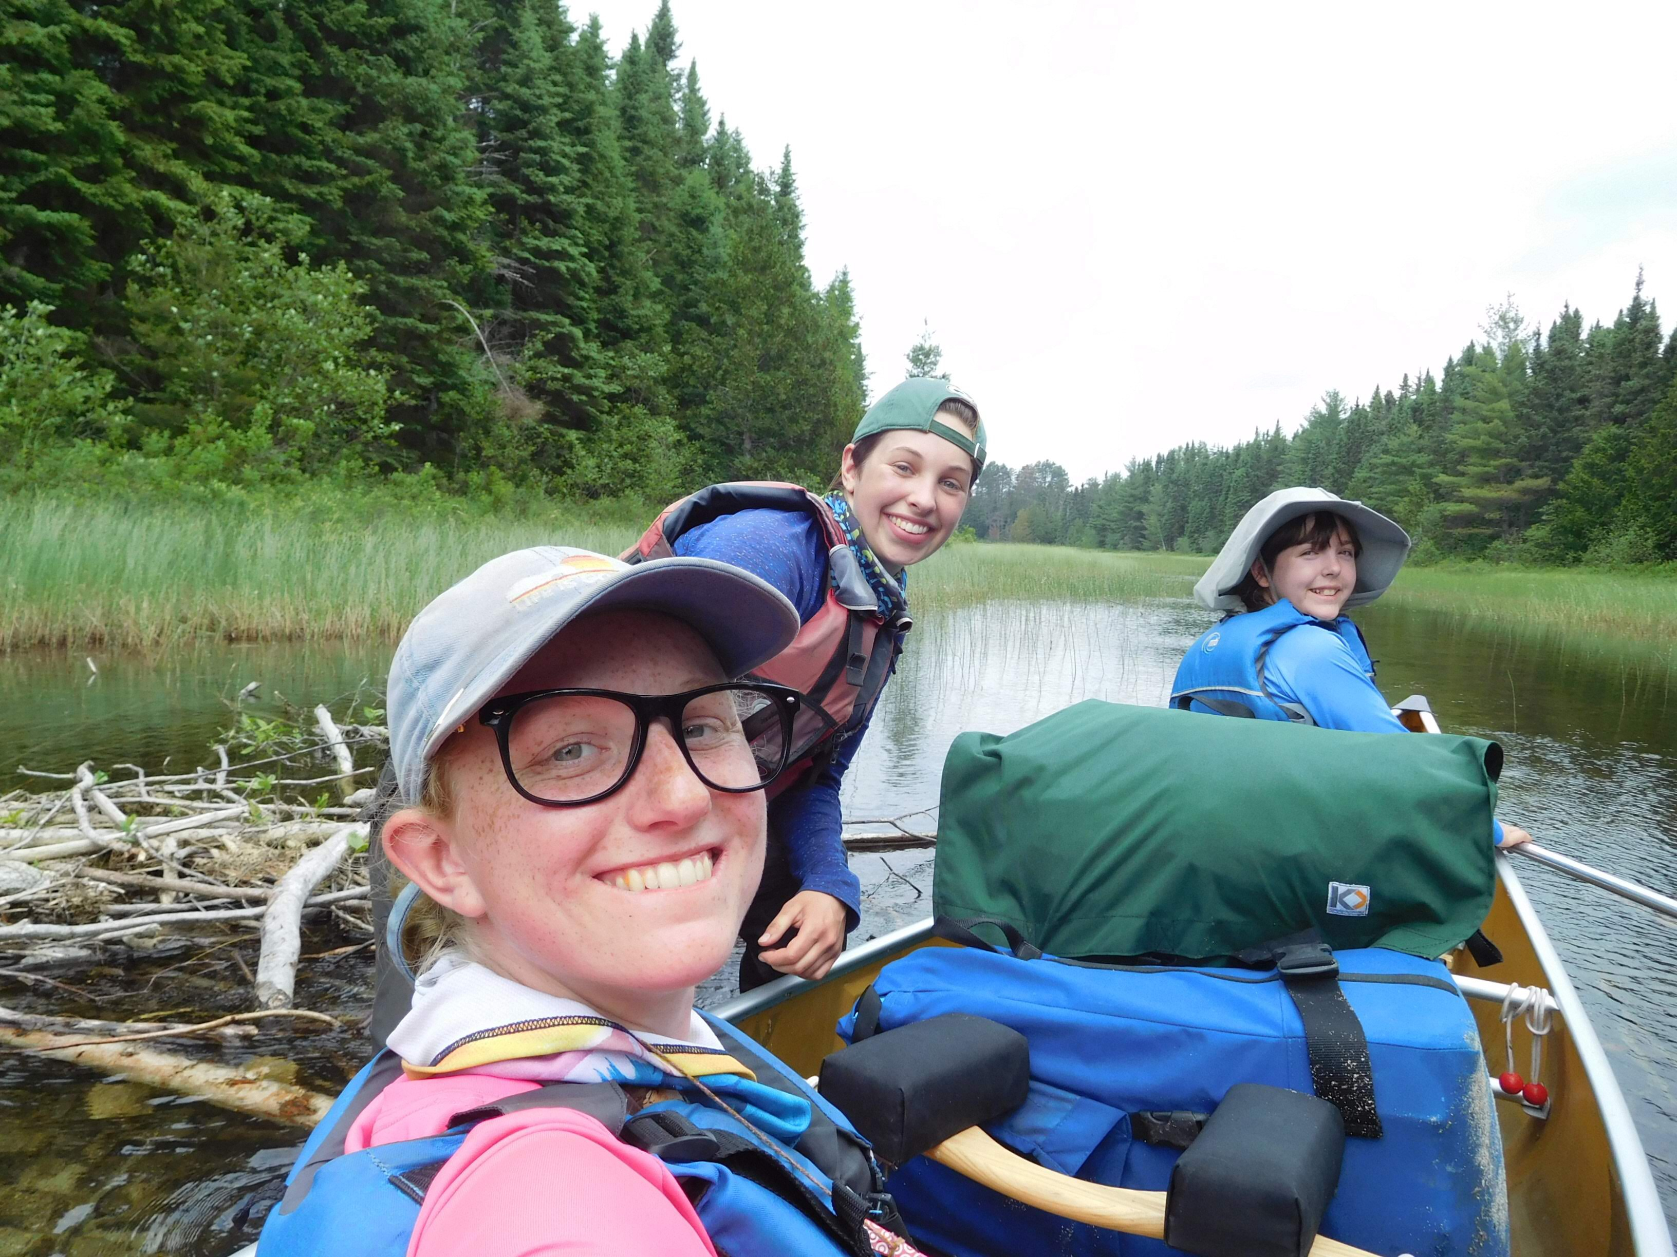
We are an all Girl Scout wilderness tripping program for youth and adults.

Slide 4
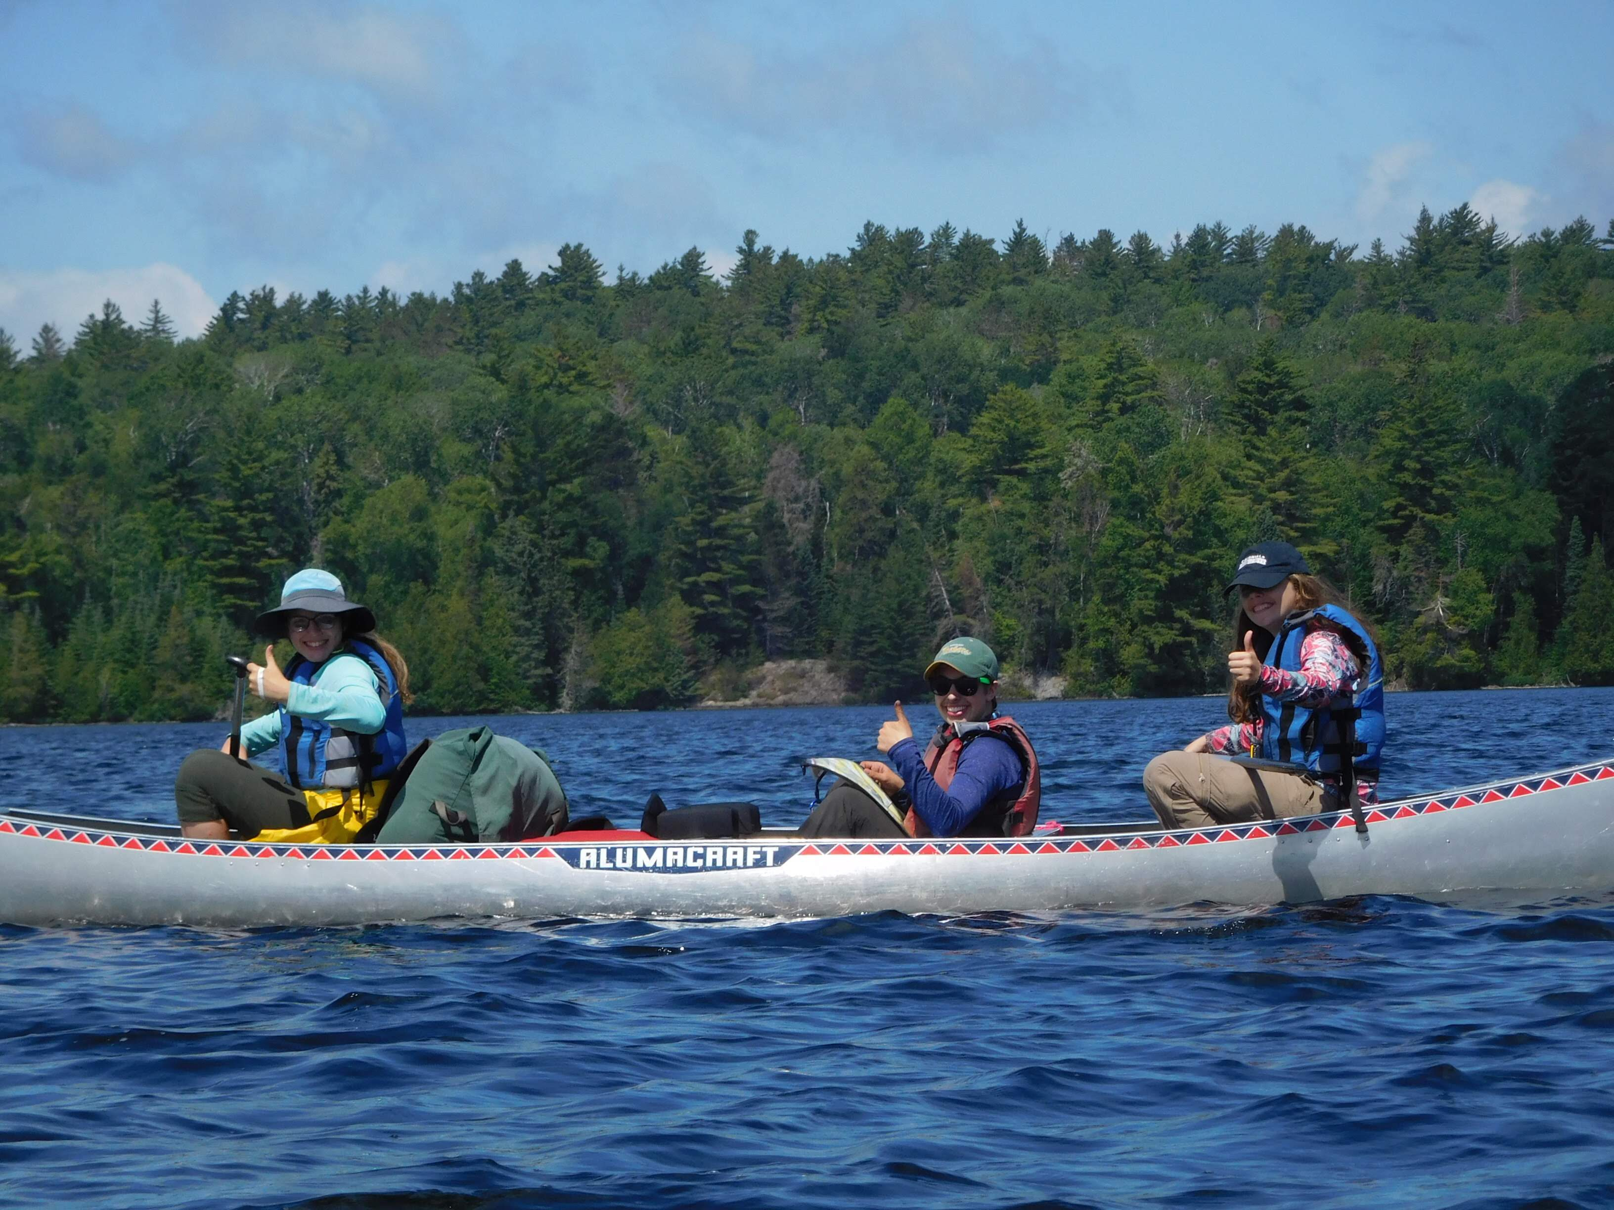

Slide 5
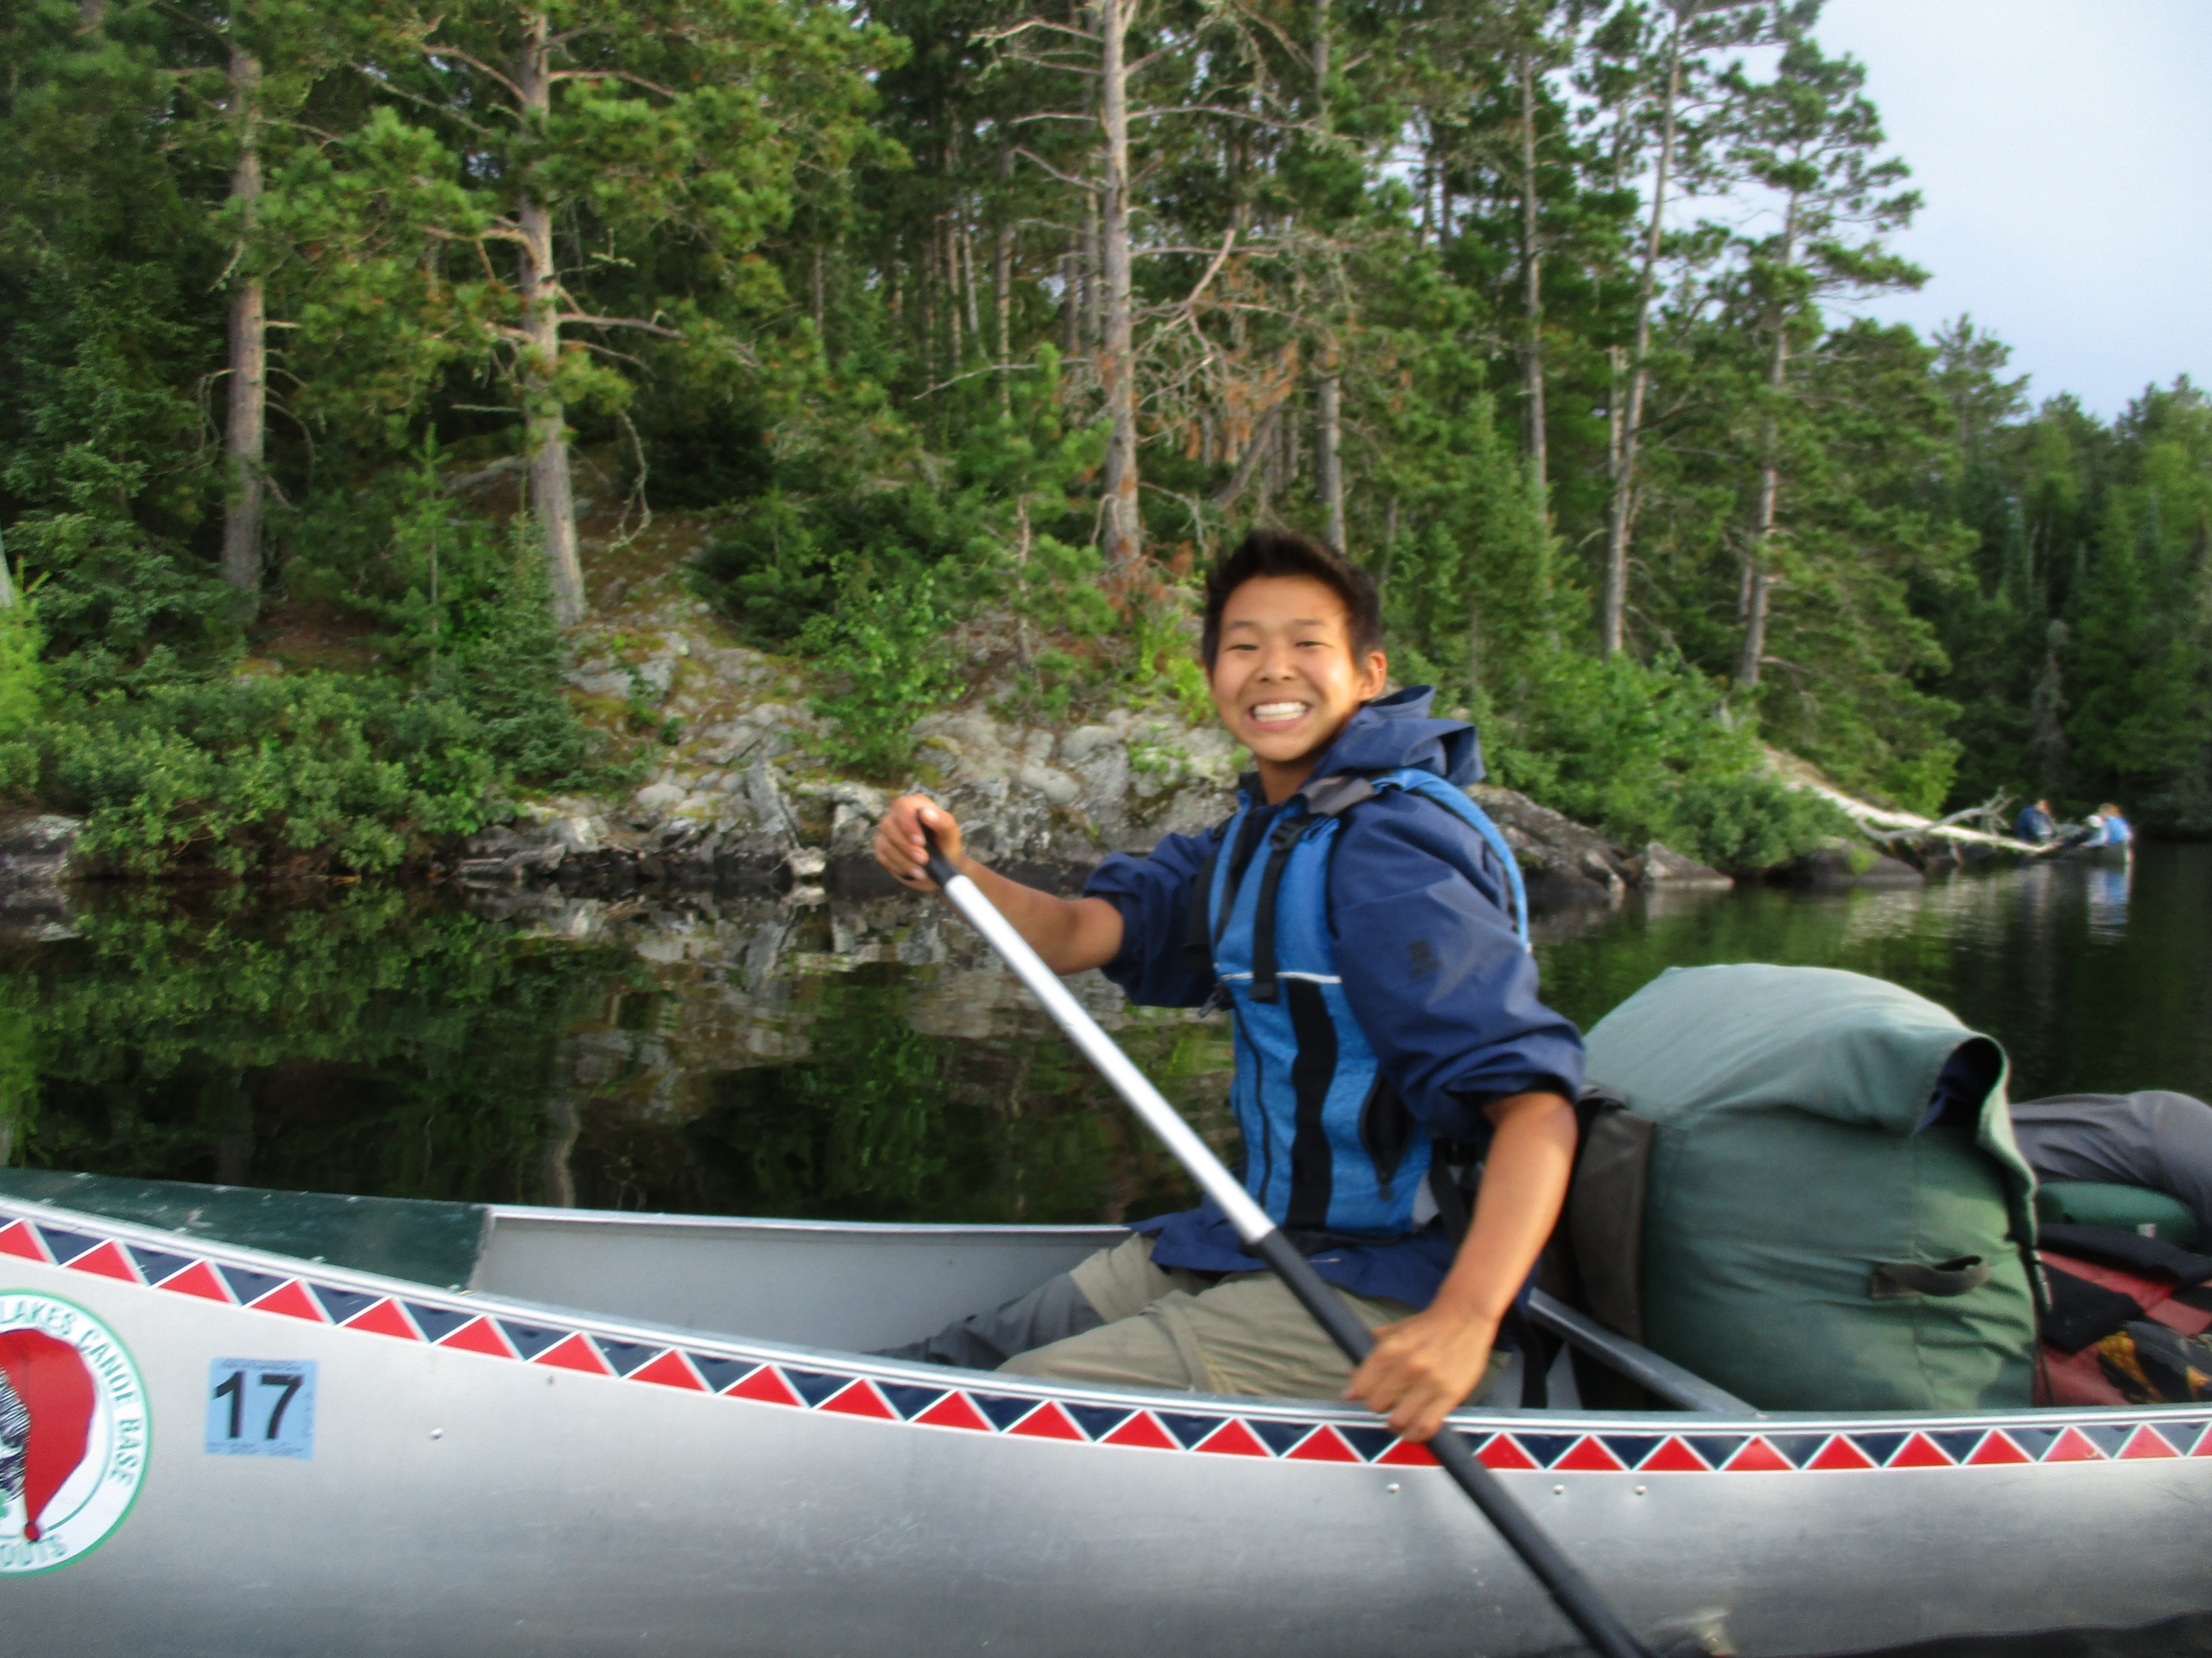

Slide 6
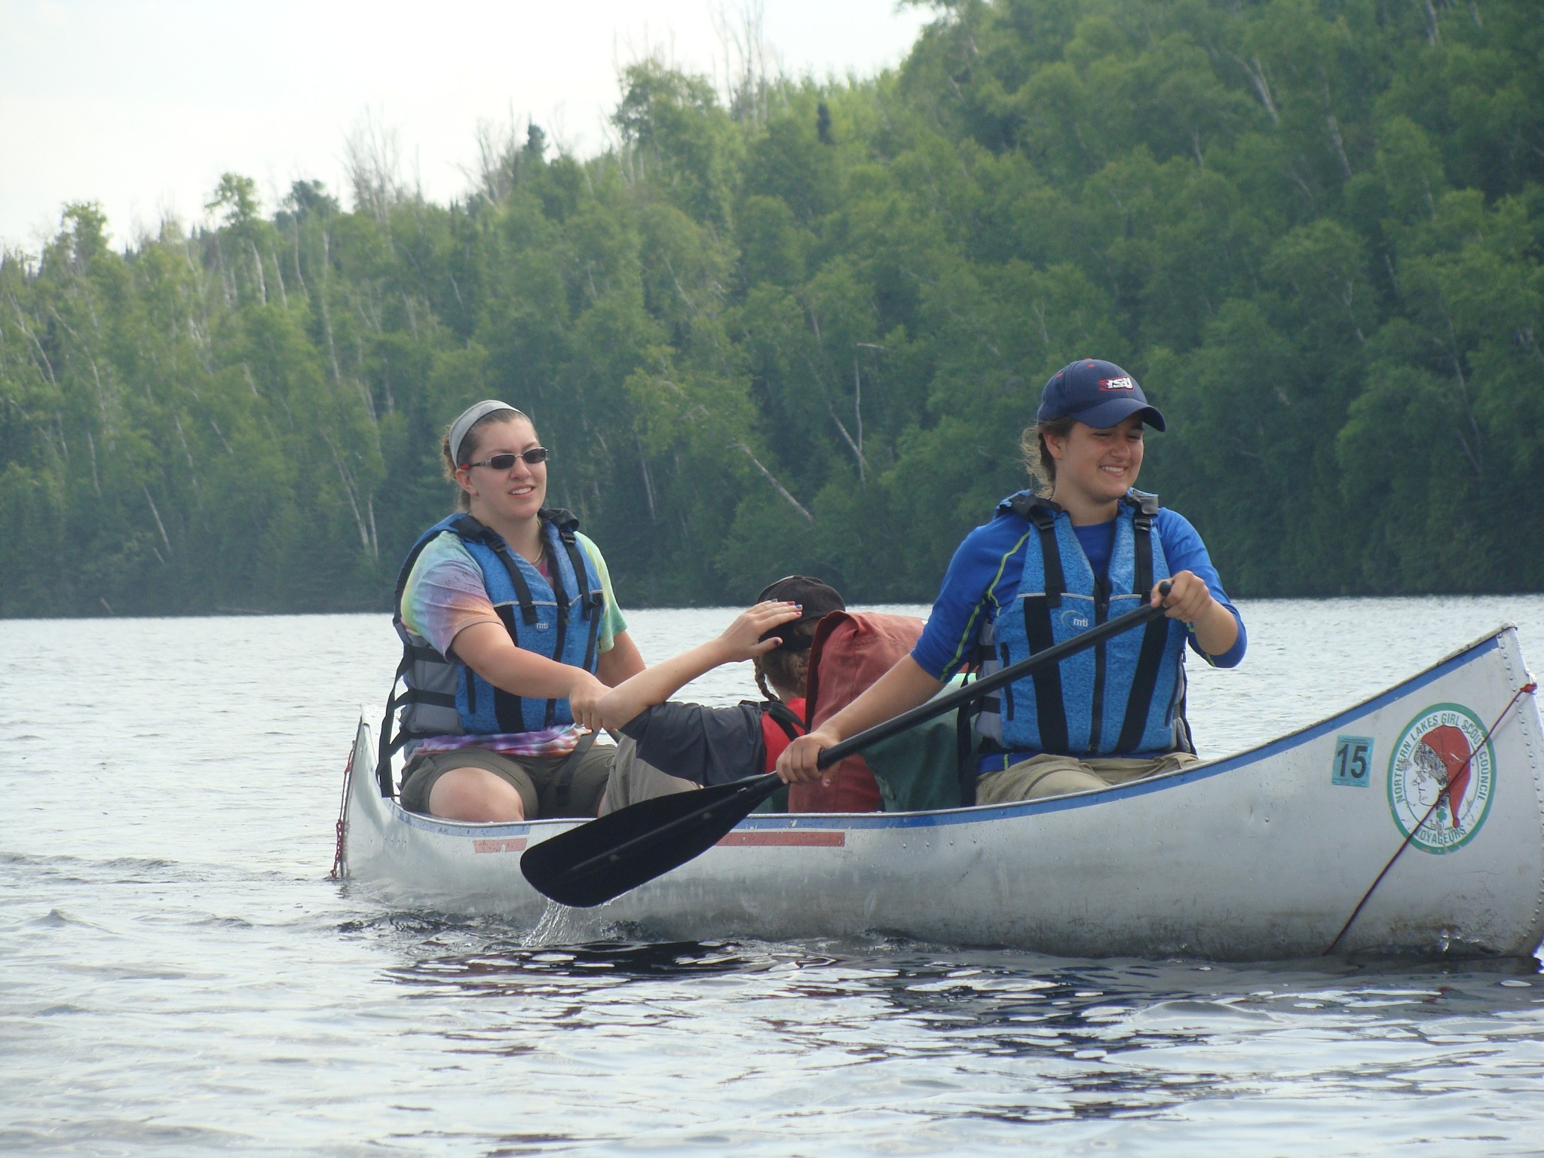

Slide 7
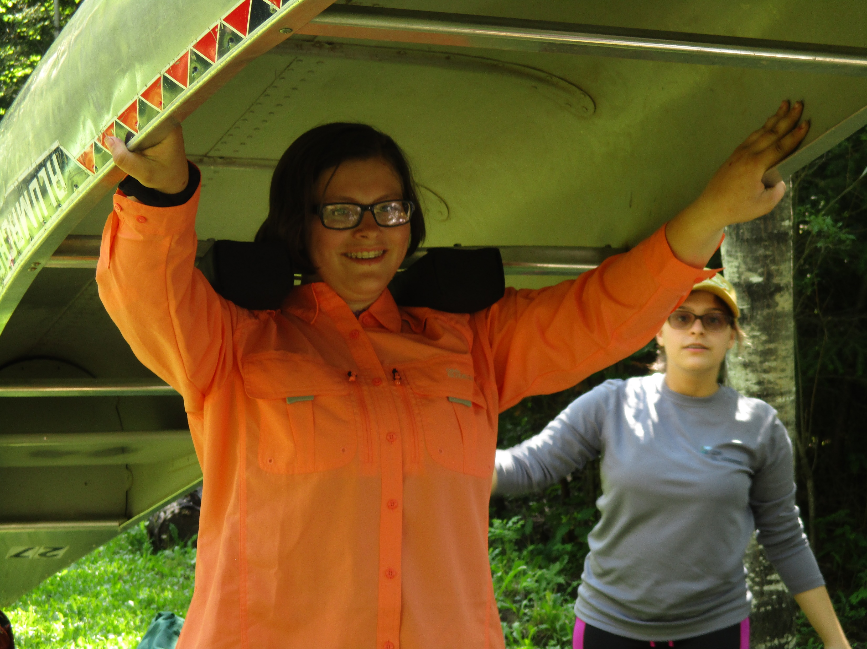
We portage our gear between lakes.

Slide 8
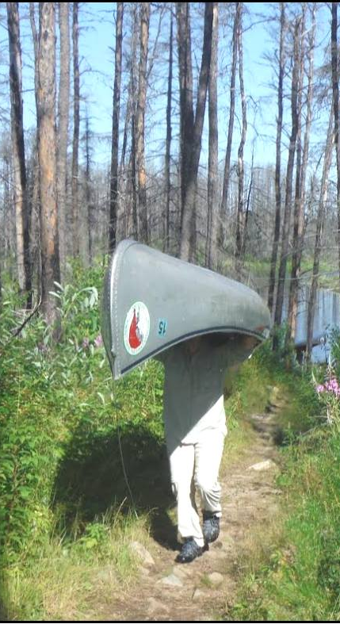
It’s like hiking with a canoe on your head.

Slide 9
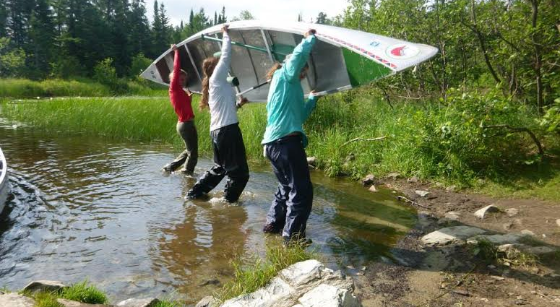
We use teamwork and technique all day, every day.

Slide 10
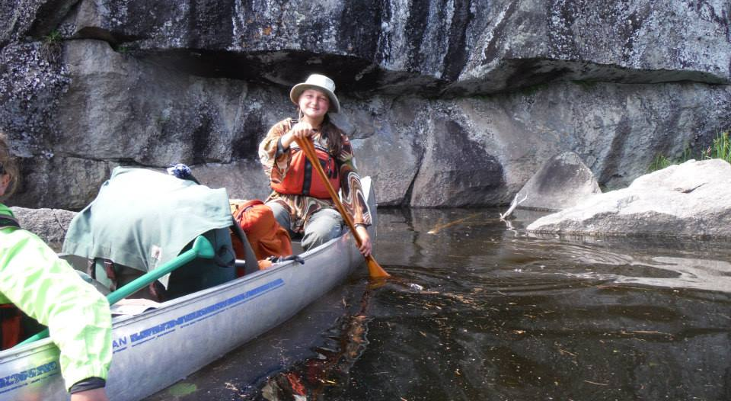
We use the J-stroke and the C-stroke.

Slide 11
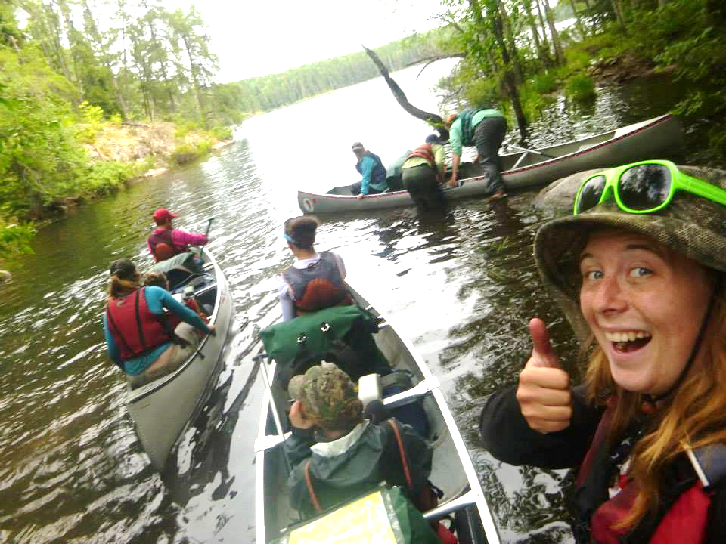
We get our feet wet.

Slide 12
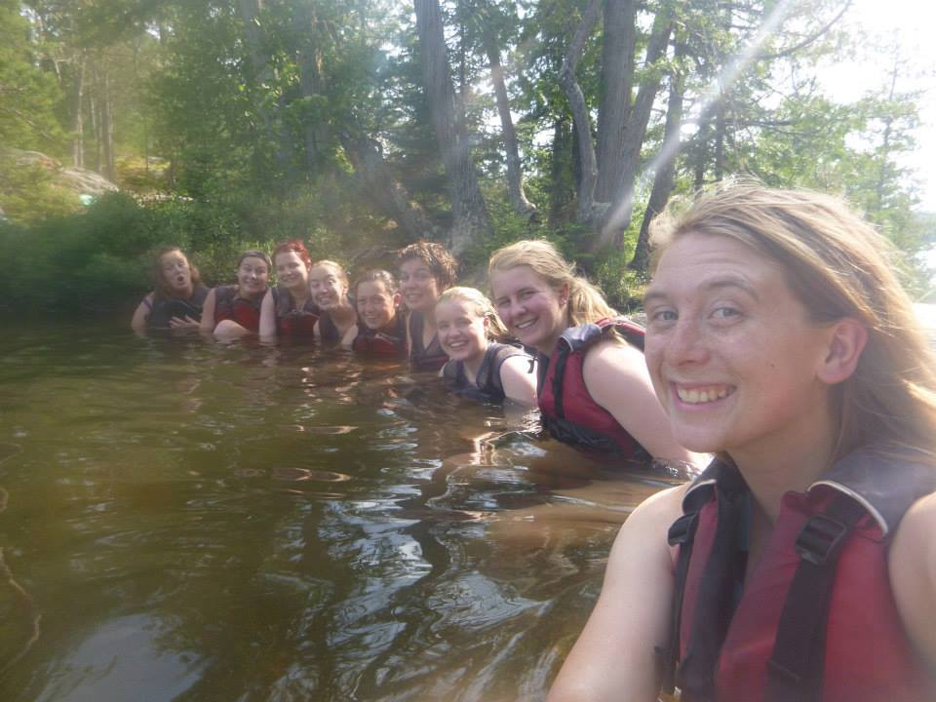
We are safety nuts.

Slide 13
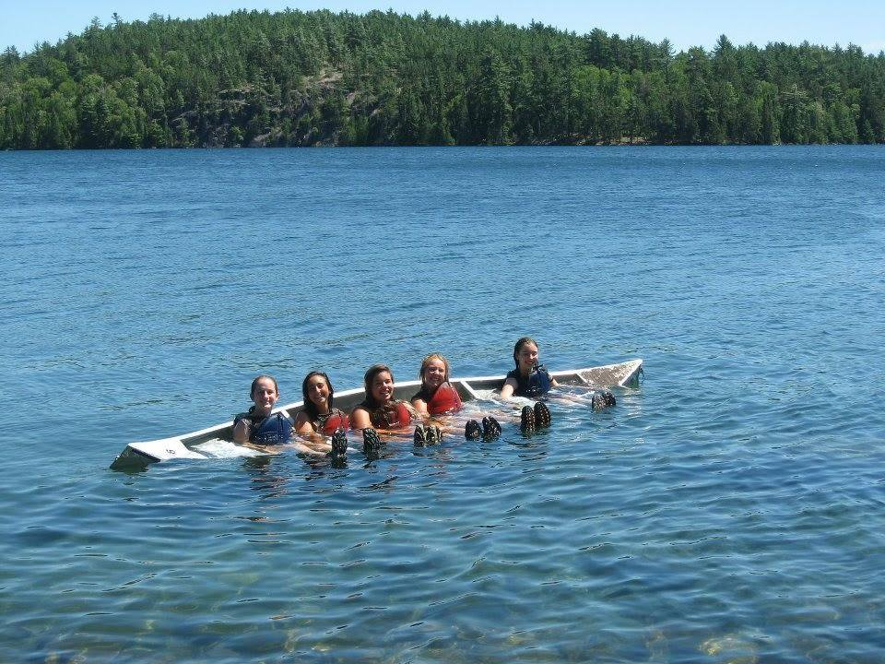
We even wear our boots when we swim.

Slide 14
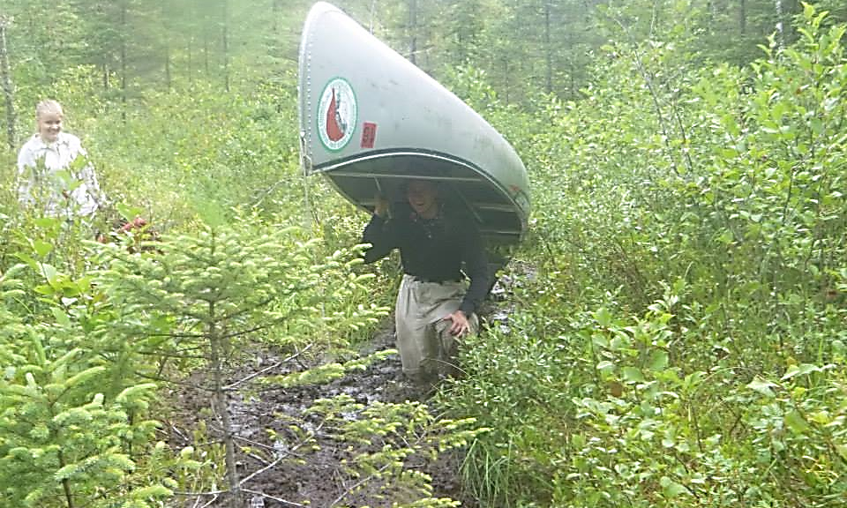
We are never without a buddy!

Slide 15
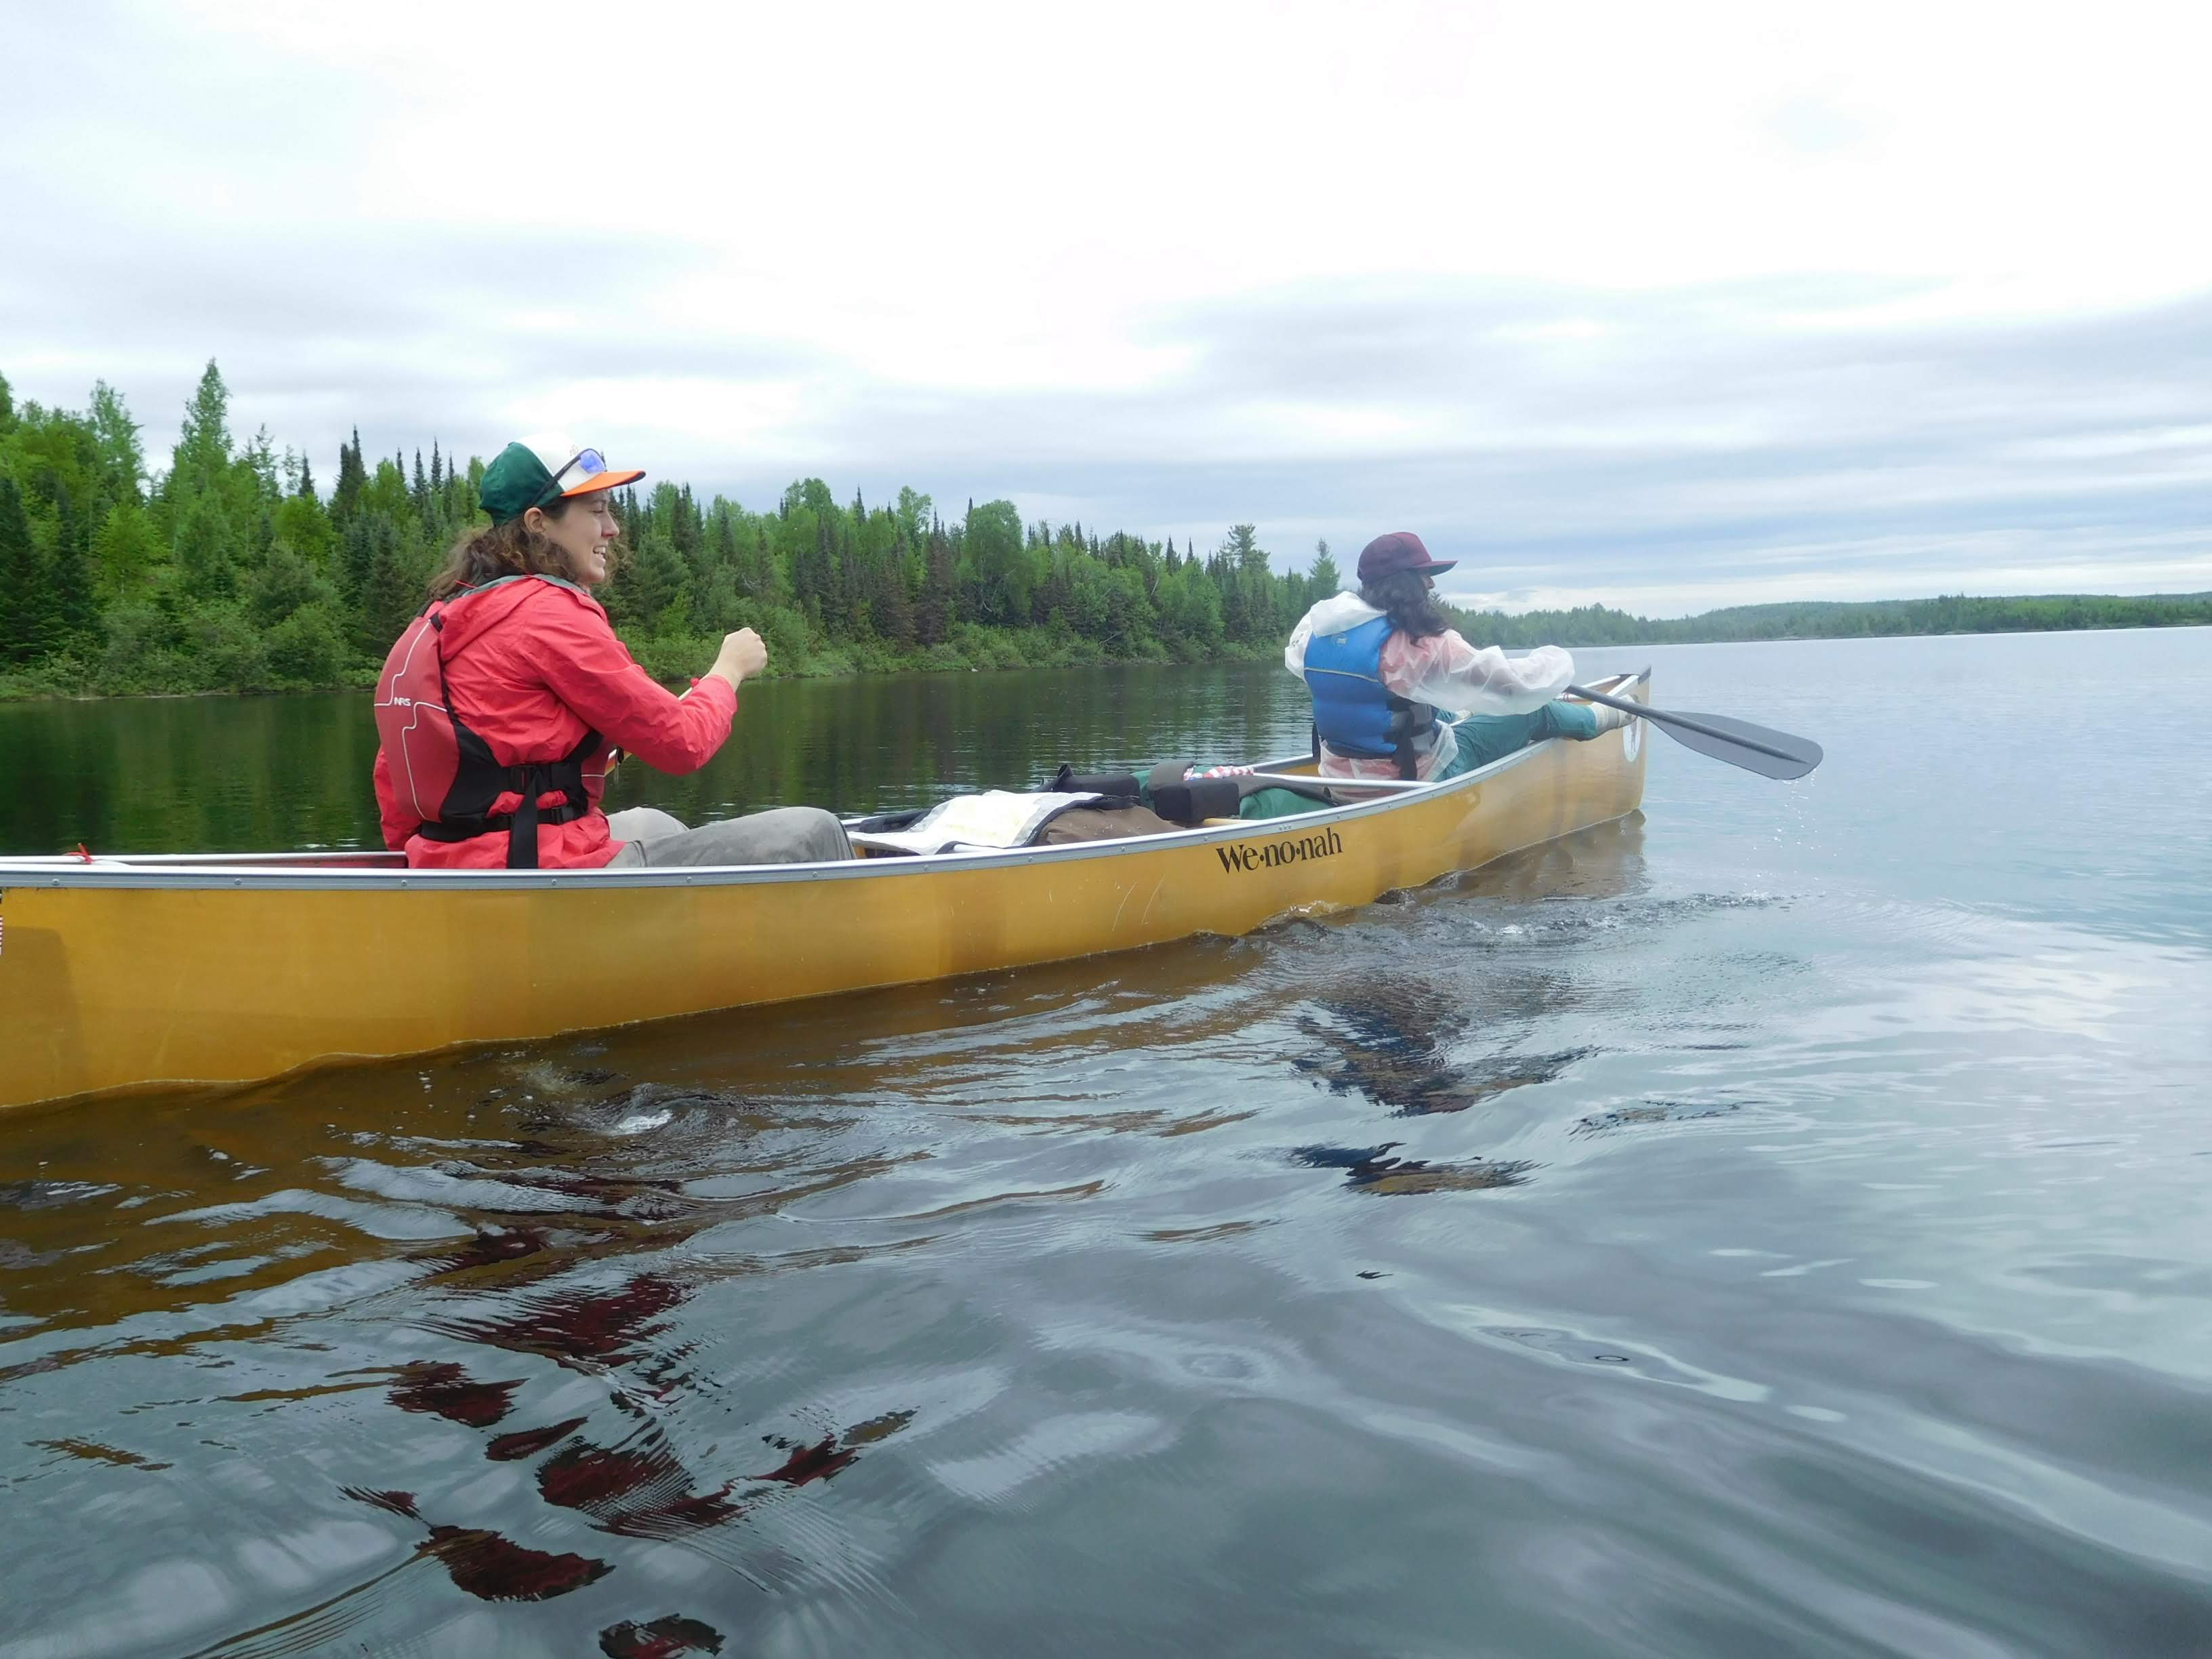

Slide 16
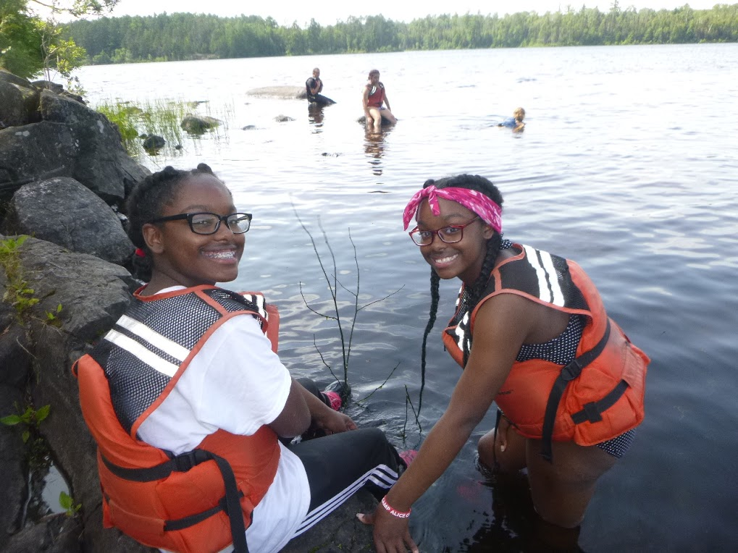

Slide 17
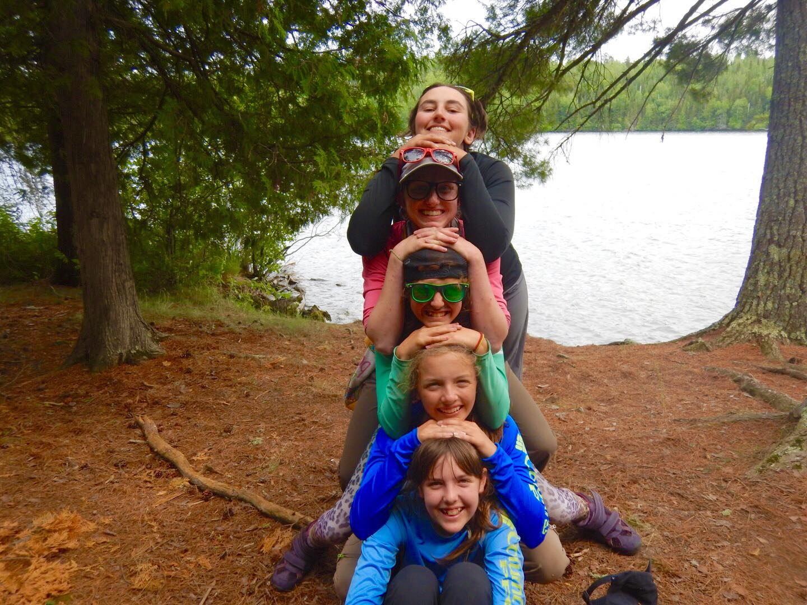

Slide 18
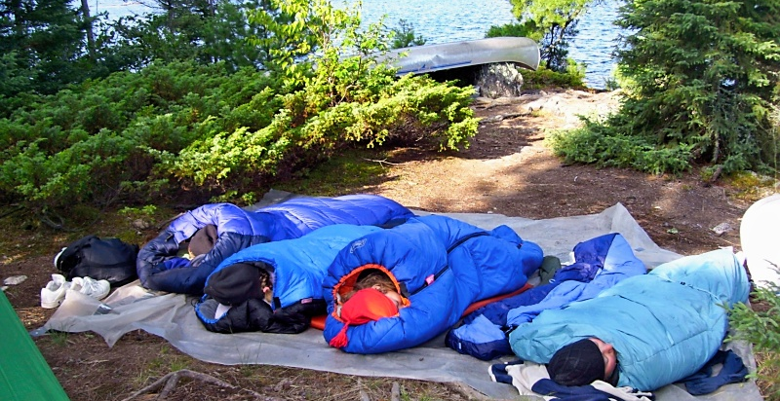
Sometimes we forget to sleep in the tent. We love stargazing…

Slide 19
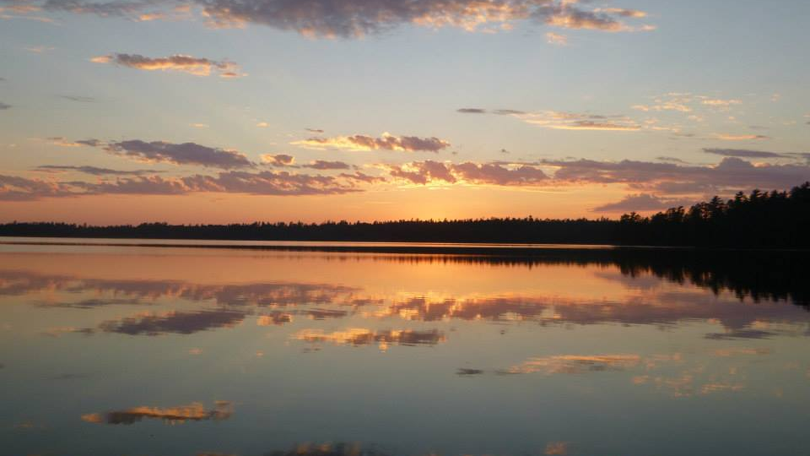
And sunset gazing

Slide 20
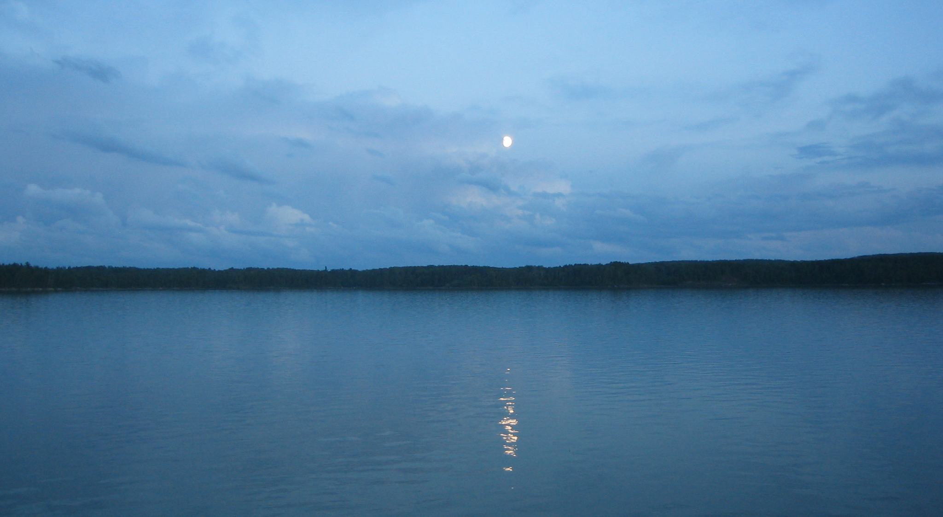
And moongazing

Slide 21
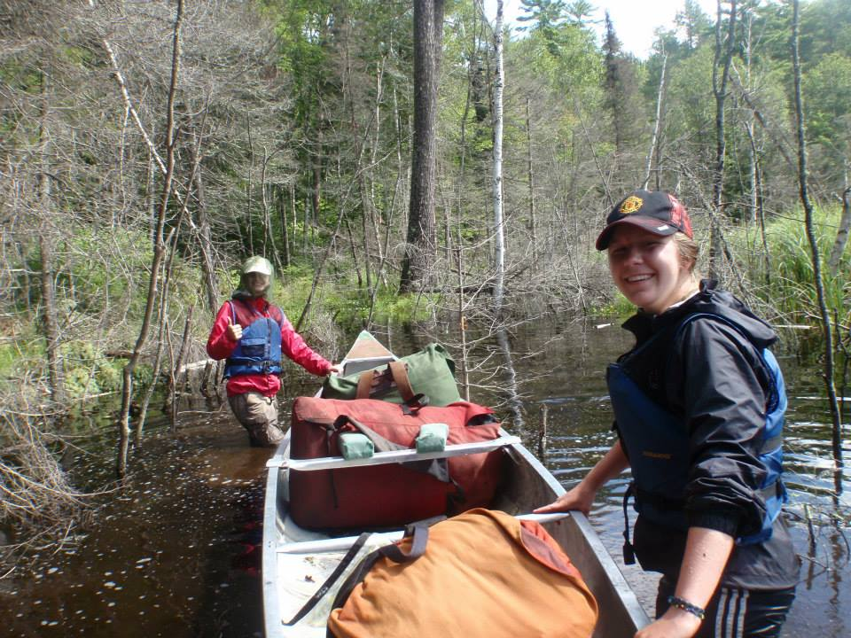
We still smile when we are knee-high in muck.

Slide 22
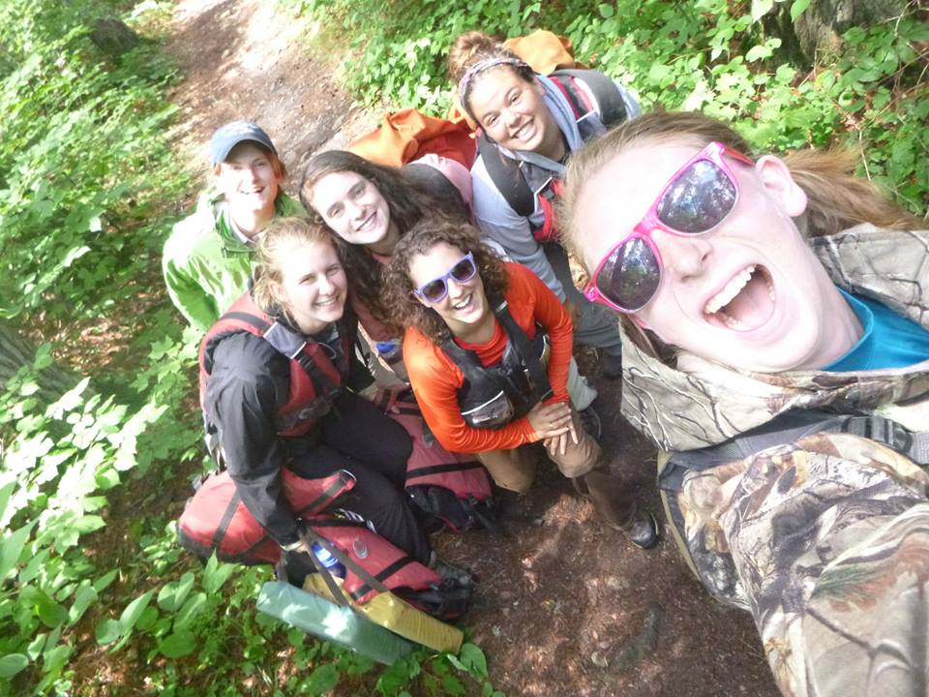
We are pee your pants silly.

Slide 23
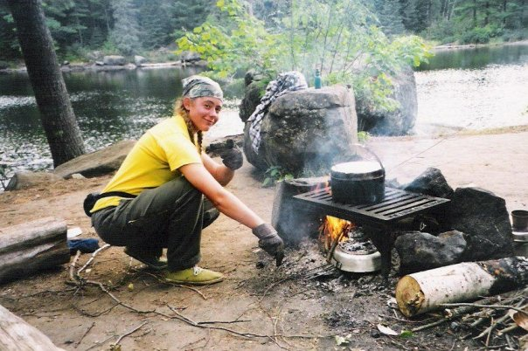
We make good meals out of simple ingredients.

Slide 24
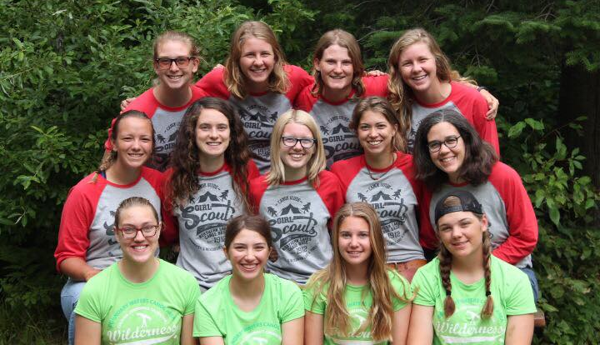
Our staff are utterly devoted to the program.

Slide 25
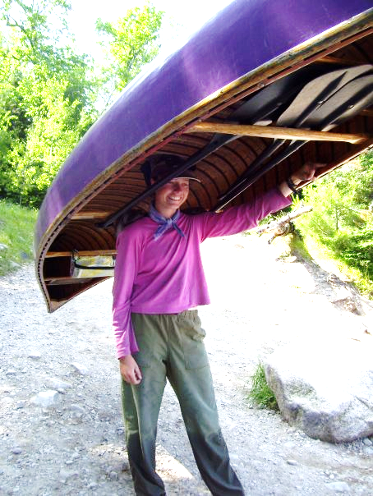
Who are the guides?
Adult Girl Scouts trained in Wilderness First Aid, Lifeguarding, and skills specific to wilderness canoe trips in the BWCAW.
Many are college-aged.
Some are graduates of our Guide-In-Training program.

Slide 26
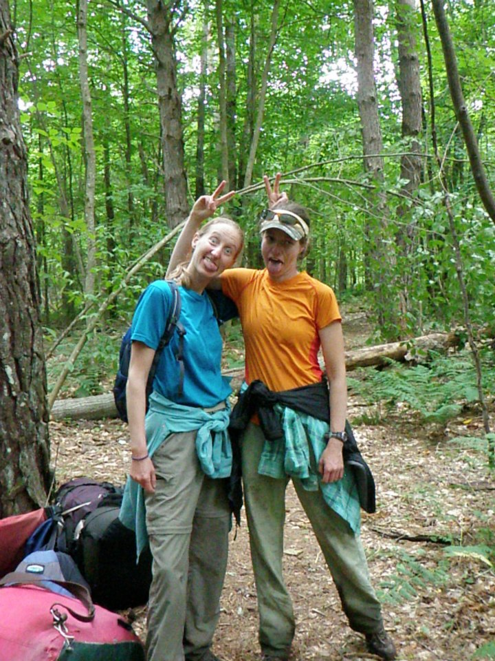
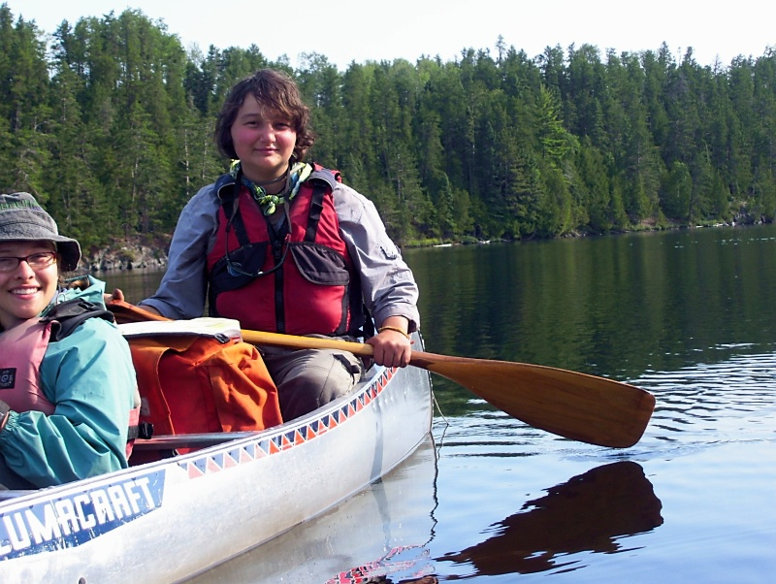
Who are the guides?
Have a mixture of Girl Scout and wilderness experience
Your safety is their number one priority
Excellent teachers and role models
Love to have FUN

Slide 27
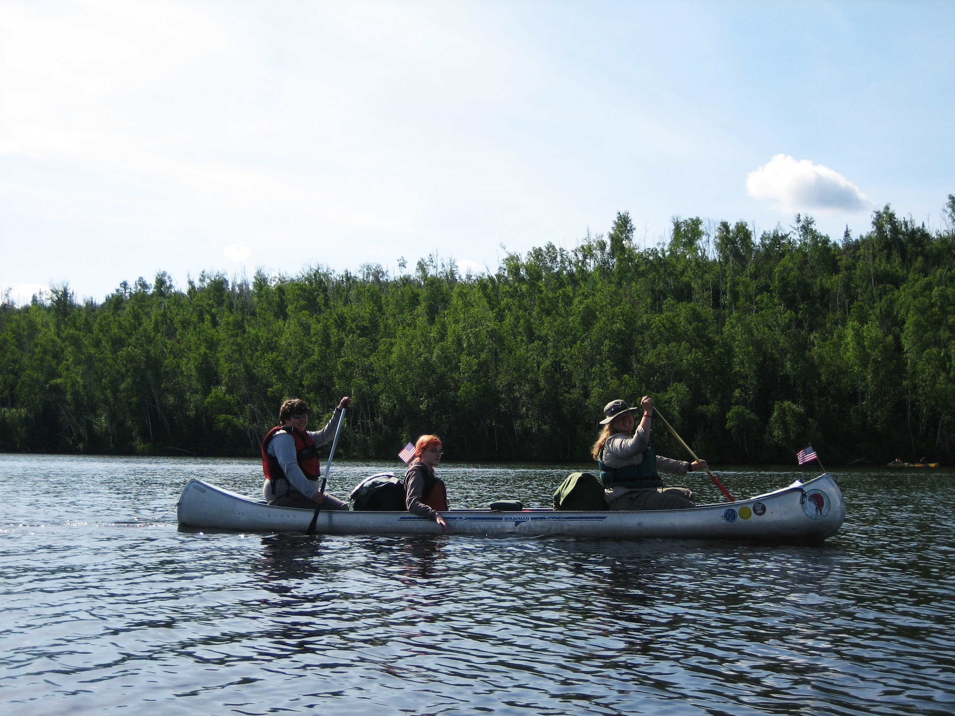
Let’s go!

Slide 28
We’re in Minnesota!

Slide 29
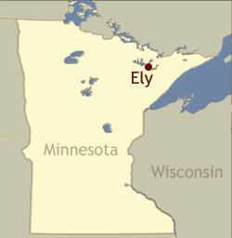
Ely, Minnesota
The Northern Lakes Girl Scout Canoe Base is about 20 minutes outside of Ely, MN and about 2 miles by canoe from the BWCAW and just 5 miles from Canada.
FUN STARTS HERE!

Slide 30
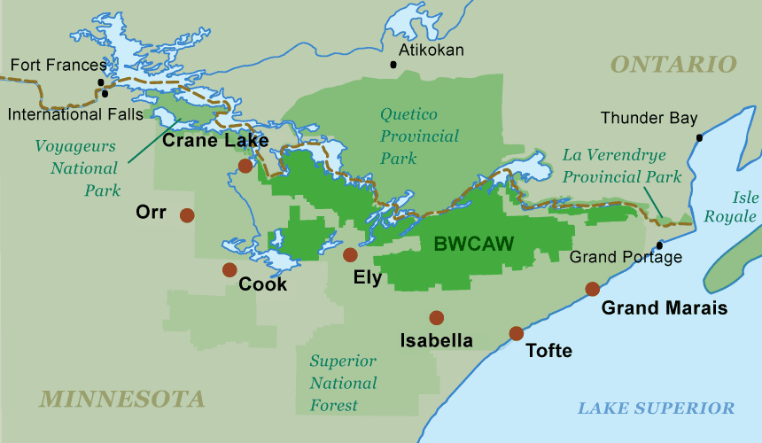
Our region

Slide 31
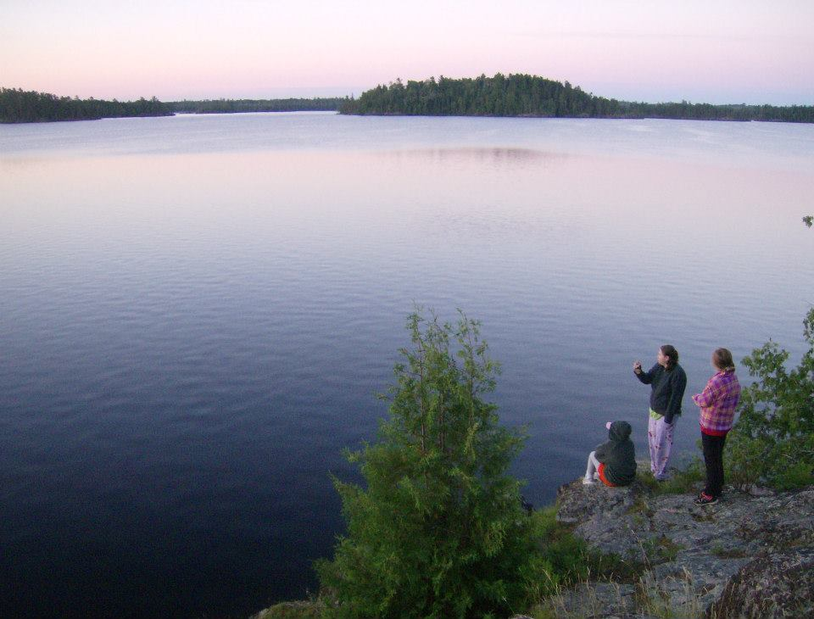
The Boundary Waters Canoe Area Wilderness
A wilderness and paddling paradise!

Slide 32
What is the BWCAW?
It is a federally-designated wilderness area
No cars
No roads
No buildings
No airplanes
1.1 million acres of pure wilderness
Quetico Provincial Park in Ontario, Canada, is just across the international border, another 1.4 million acres of pure wilderness!

Slide 33
What is the BWCAW?
Only water, trees, rocks, stars, blueberries…
Wildlife
Loons
Eagles
Moose
Black bears
Remnants of history
Pictographs
Lumber industry
Fur trading

Slide 34
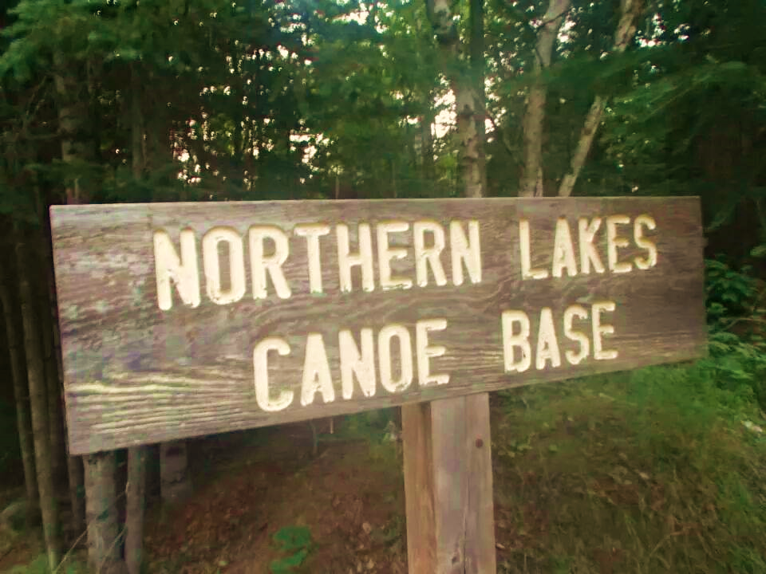
What to expect on your guided Girl Scout canoe trip
You will start with training at our canoe base.

Slide 35
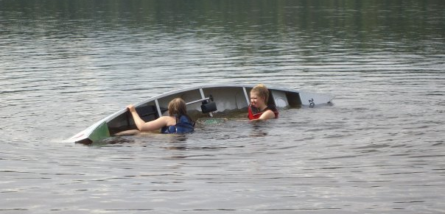
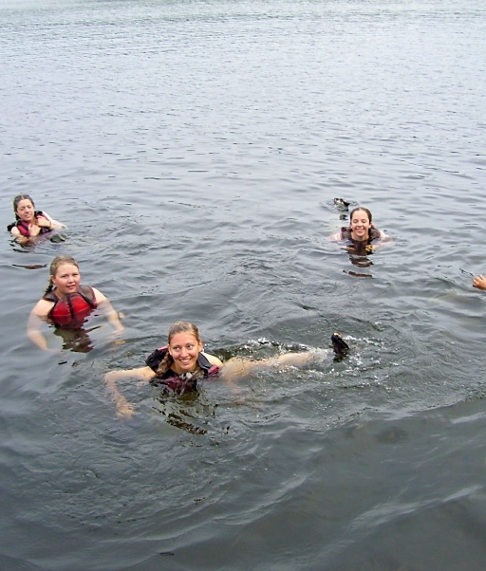
Arrival Day at the NLCB
Learn how to (or refine your skills):
Paddle
Use teamwork to portage
Practice tipping your canoe and perhaps have some time for “free swim”
Be safe and follow Forest Service Regulations
You may do these trainings with other crews arriving on the same day.

Slide 36
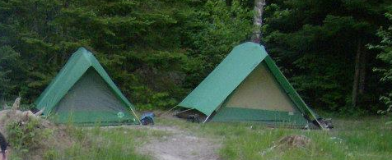
What else do we do on the first day?
You will….
Repack your gear in our canoe packs
Eat dinner at your campsite
Set up and sleep in tents in our campsite area

Slide 37
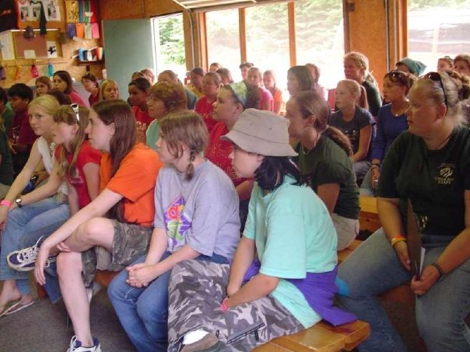
You will attend our Safety Talk in the Program Center.

Slide 38
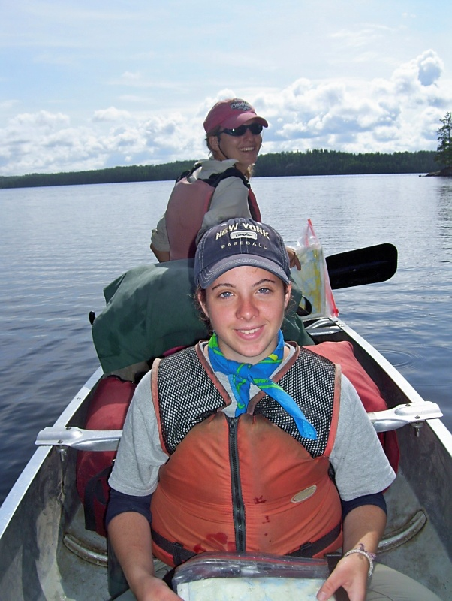
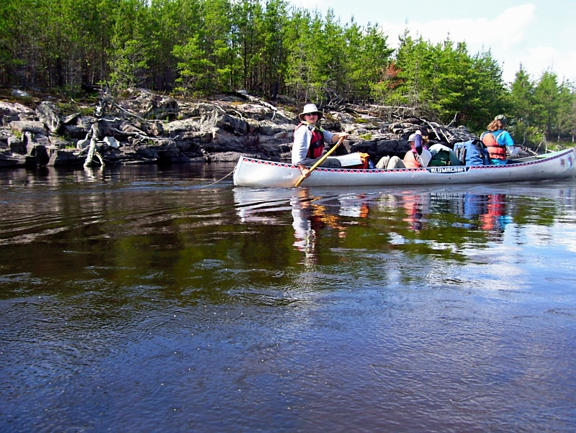
Day 2 and beyond
Wake up, eat breakfast, and head out on your canoe trip around 9am!
From the second day on, you will be paddling and portaging through different lakes in the BWCAW or Quetico, setting up a new campsite each night.

Slide 39
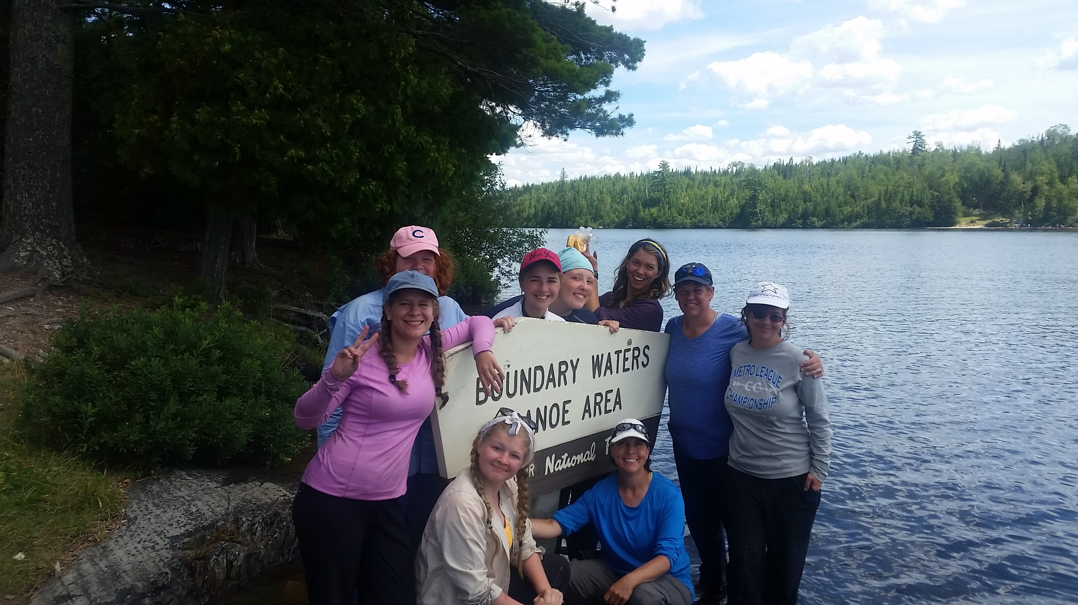
Your crew of 9 or fewer people will be traveling and camping by itself, although you will probably see other crews along the way.

Slide 40
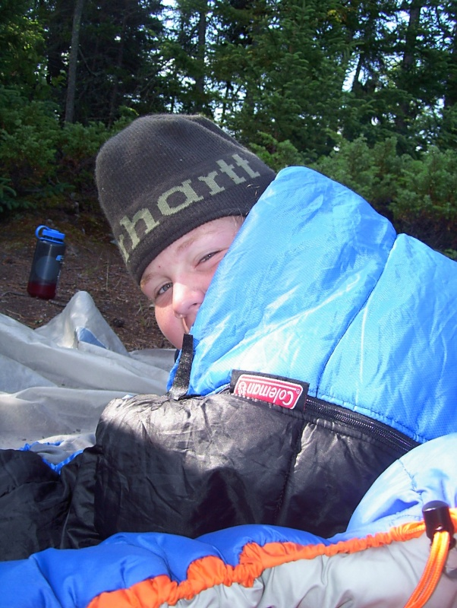
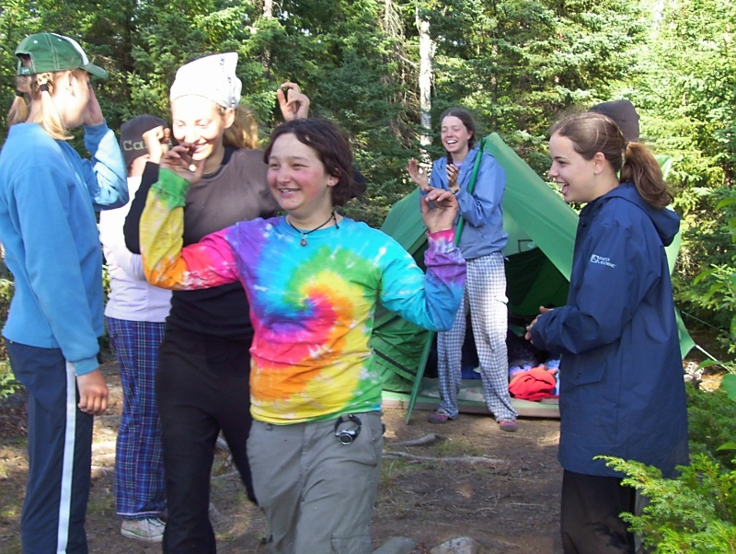
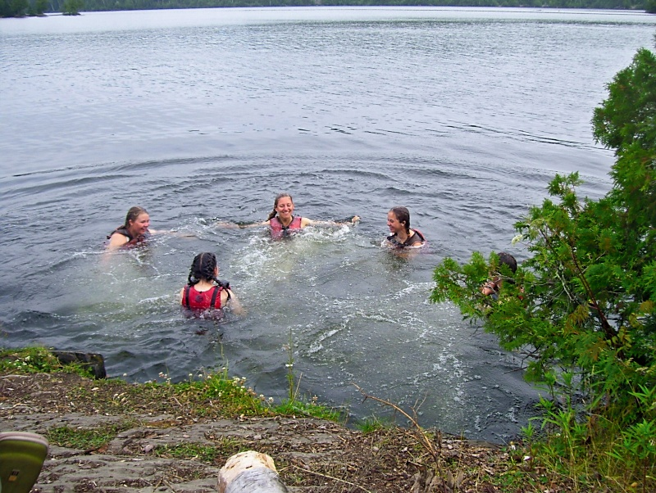
Layover Day!
You will have a “layover day” in the middle of your trip and stay at the same campsite for two nights.
You’ll have a chance to sleep in, swim, play games, read and relax. Some groups may choose to take a day trip.

Slide 41
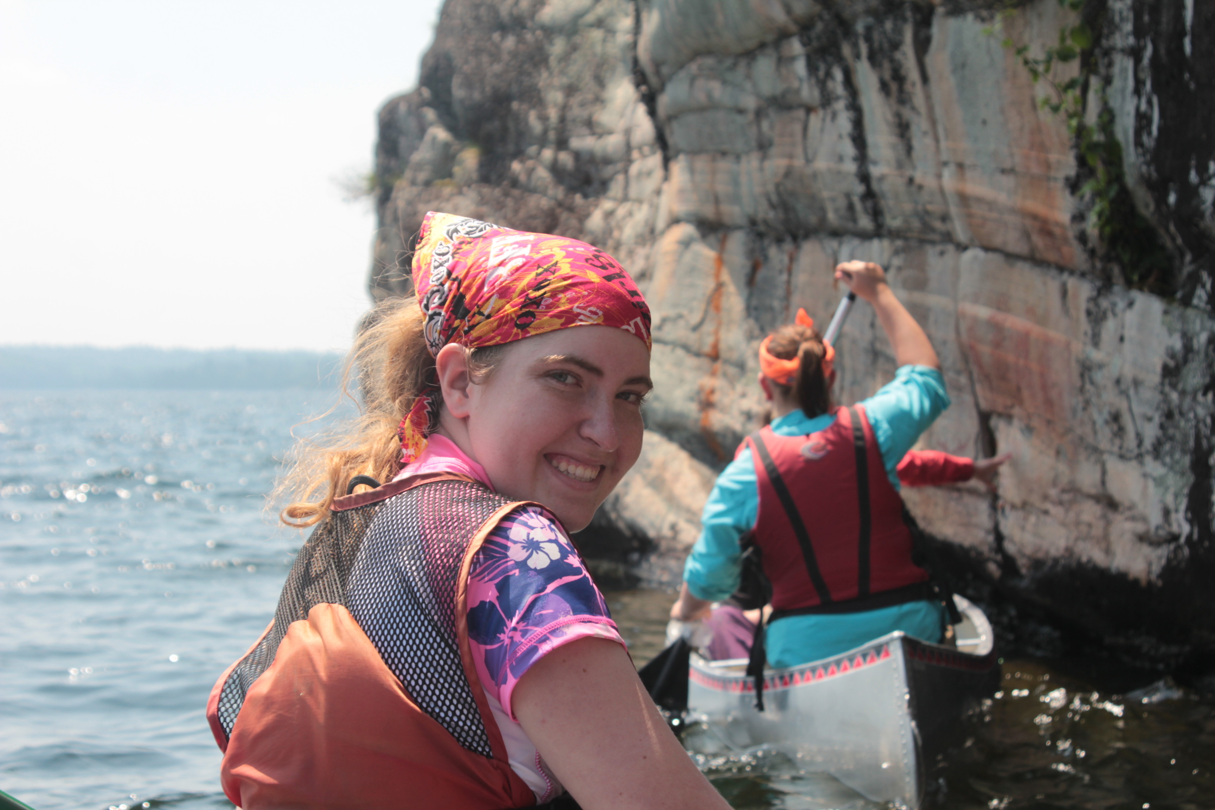

Slide 42
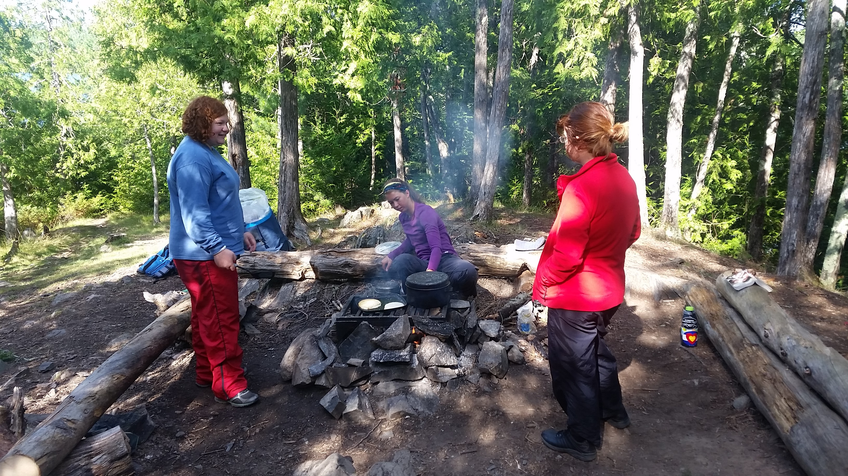
You will likely eat PANCAKES and PIZZA

Slide 43
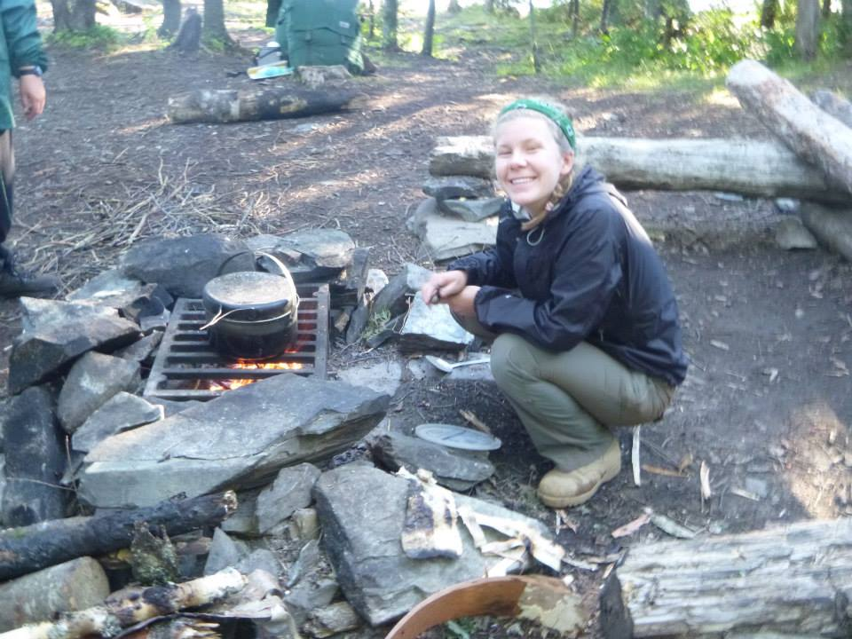

Slide 44
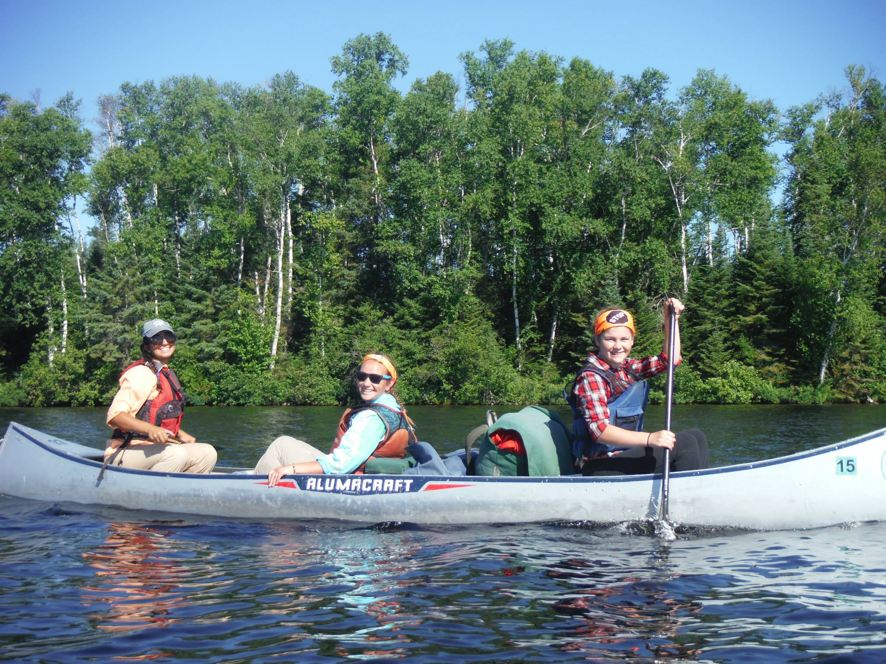

Slide 45
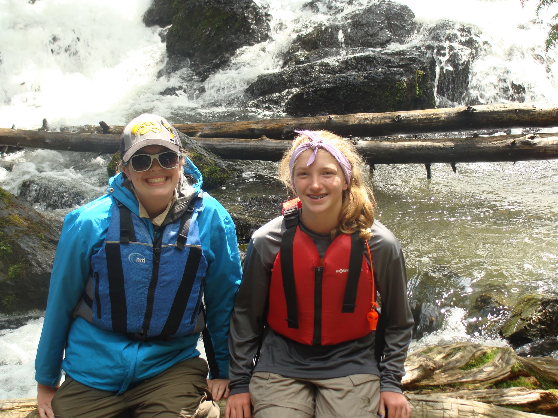

Slide 46
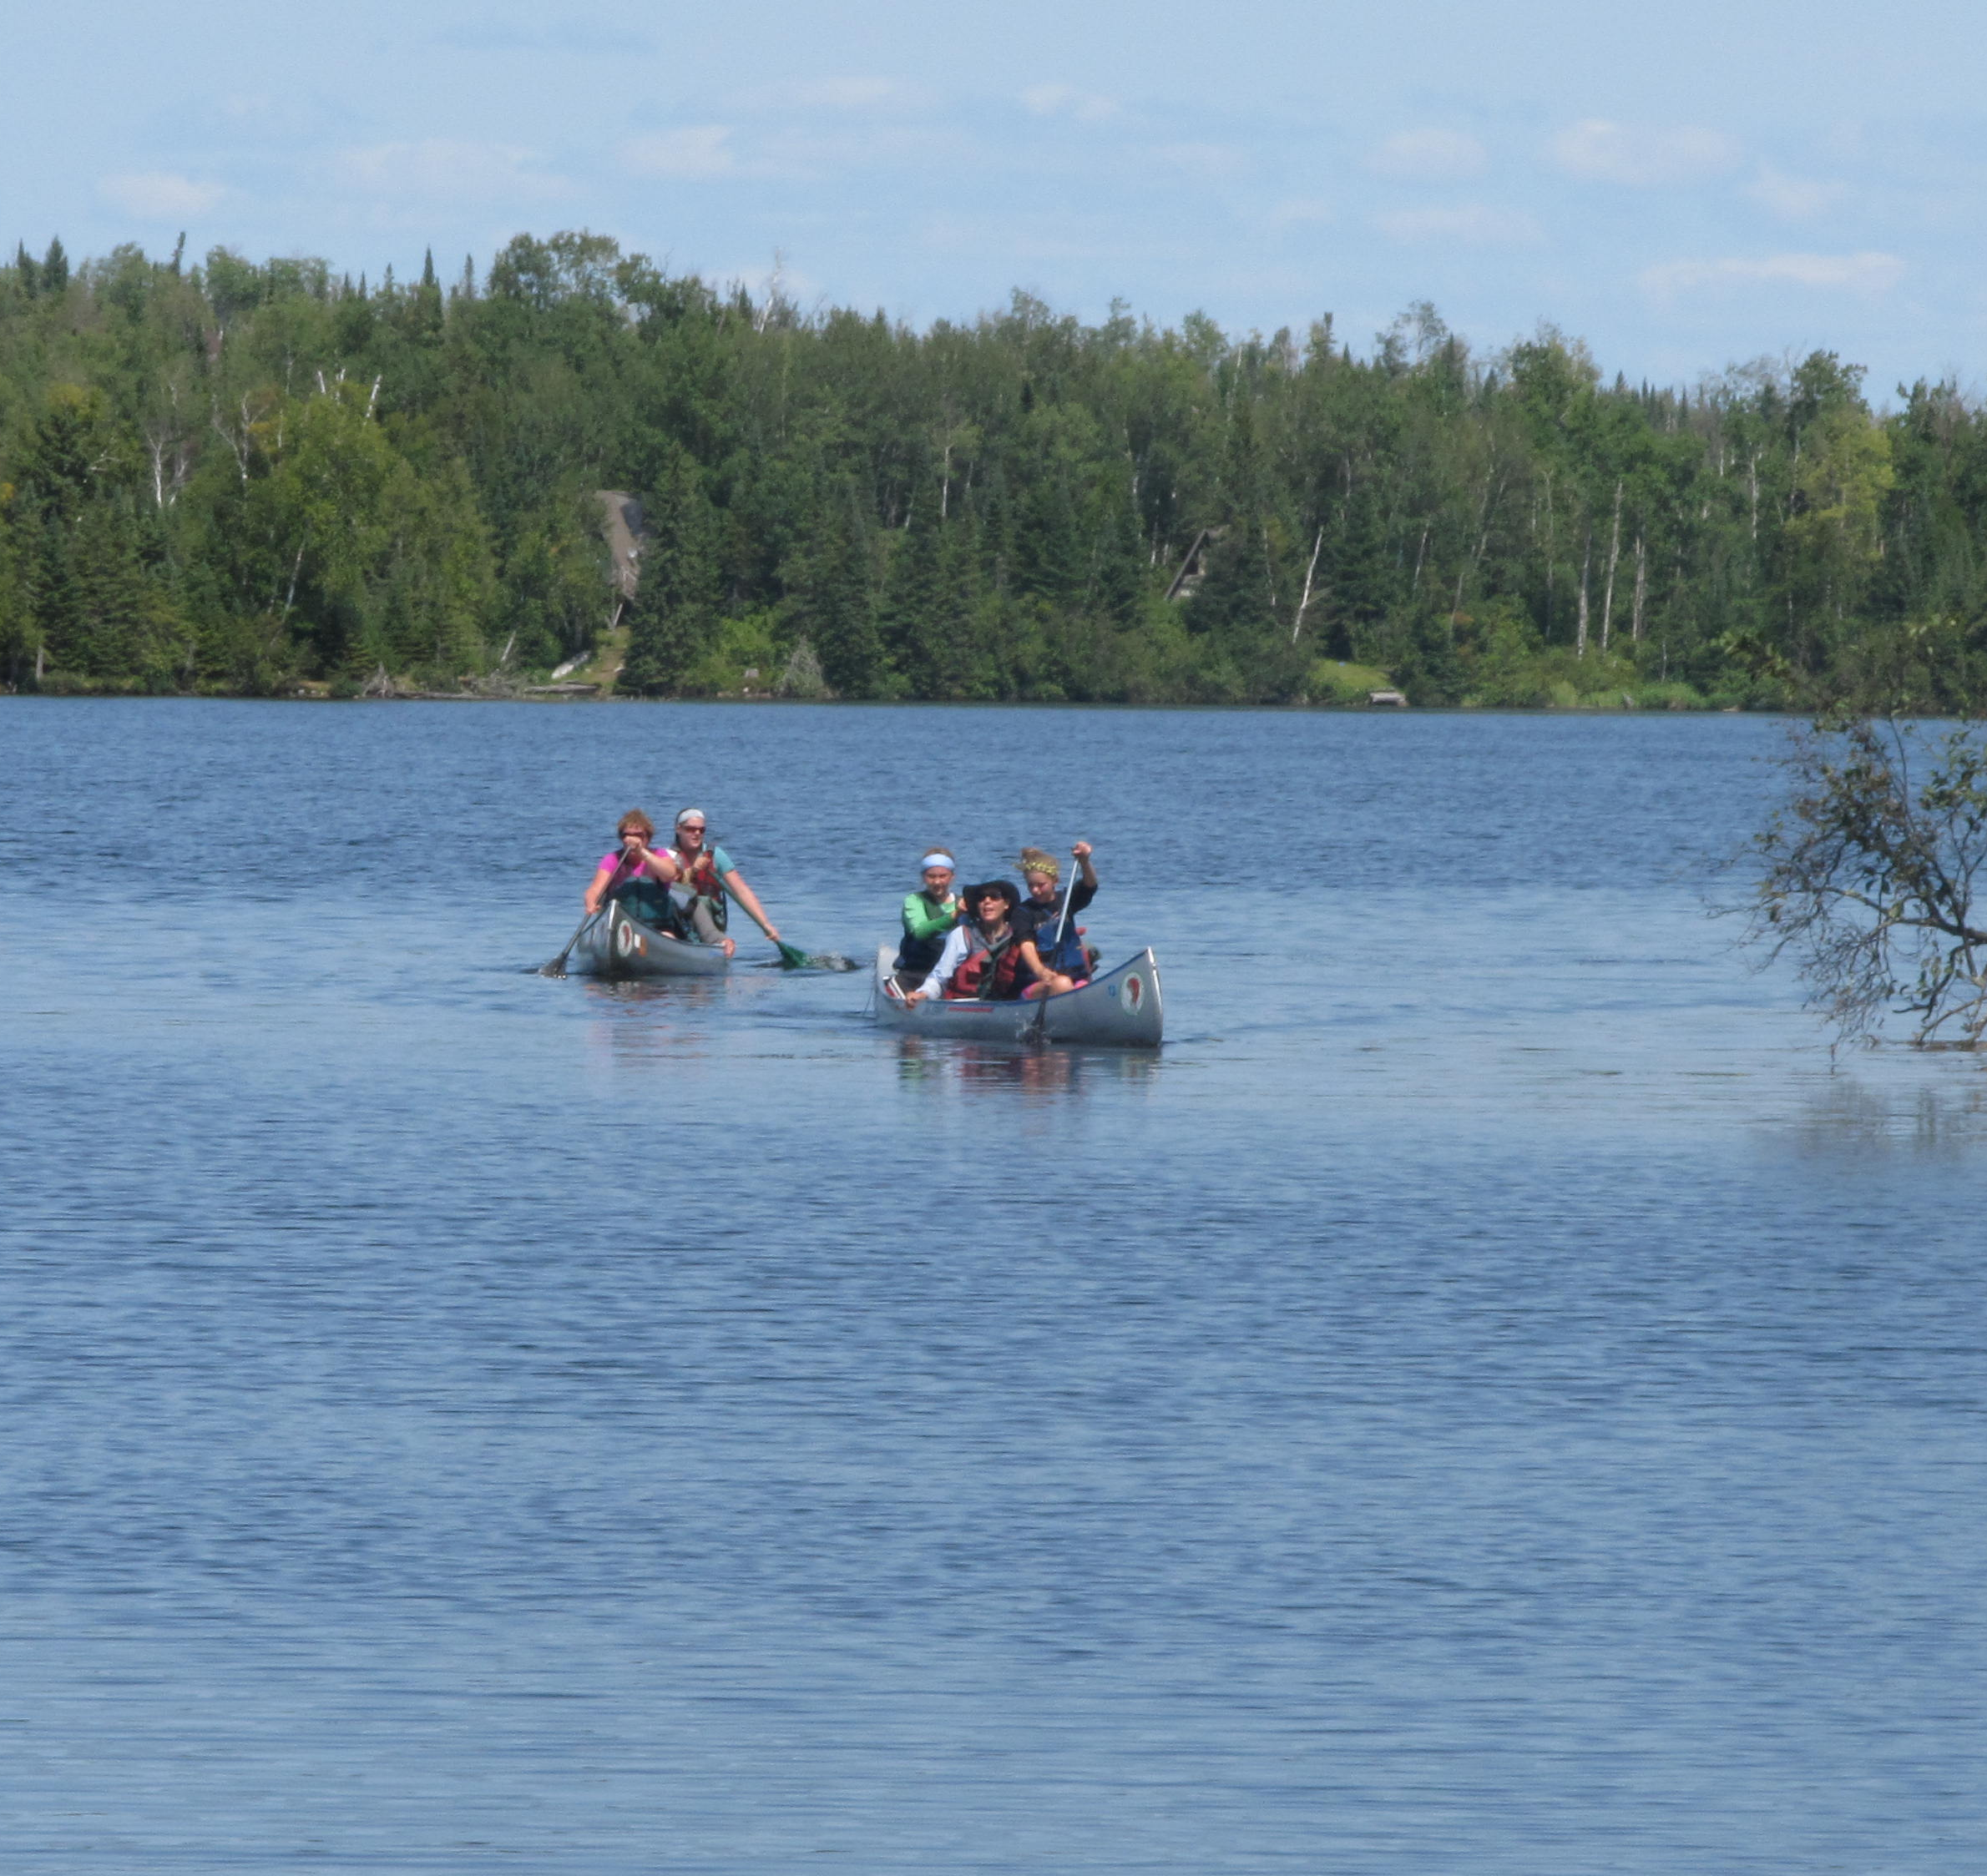
Your last day on the water
On the last day of your canoe trip, you will arrive back at the canoe base around 2 pm. We will greet you at the landing, and then you’ll:
Take a hot shower
Shop at our awesome Trading Post - Cool swag available!
Repack your gear
Say goodbye to your guides
Leave around 4pm
Notes:
We can try to get out on the road a little earlier, but make no promises in this regard, since weather can be variable on the day you paddle in.

Slide 47
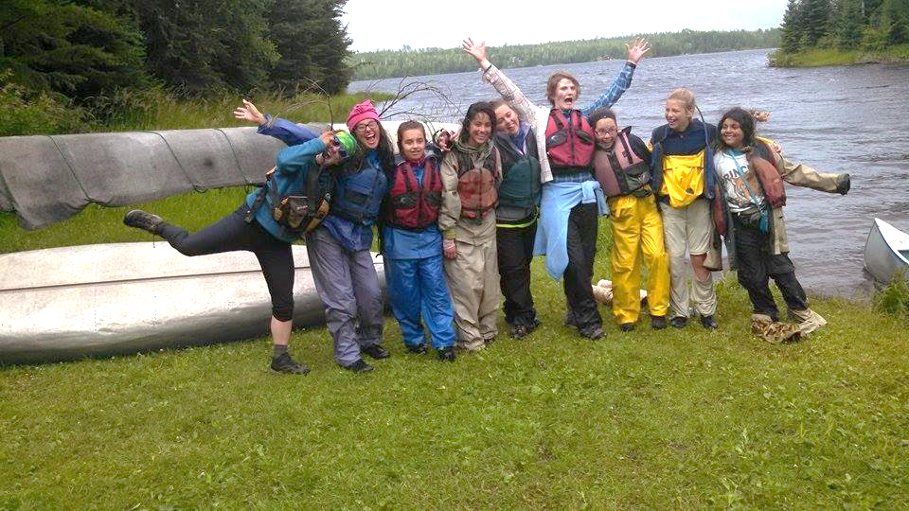
Our trips end with an unparalleled feeling of accomplishment.

Slide 48
Okay, I’m sold. What’s next?
Destination, Standard Trip, or Flex Trip?

Slide 49
What is a Destination?
For Cadette, Senior, and Ambassador Girl Scouts who will travel independently
Apply for a trip on their own
Make friends from all over the country as they travel with other Girl Scouts

Slide 50
North Country Rock-N-Wilderness includes a whitewater adventure, ropes course, and a 7 to 10-day canoe trip
Session 1: July 5-16, 2024
Cadette–7th Grade
Cadette–8th Grade
Senior–9th Grade
Session 2: July 22 - Aug 5, 2024
Senior–10th Grade
Ambassador–11th Grade
Ambassador–12th Grade
Ambassador–12th Grade Graduate
Apply for our Destination.

Slide 51
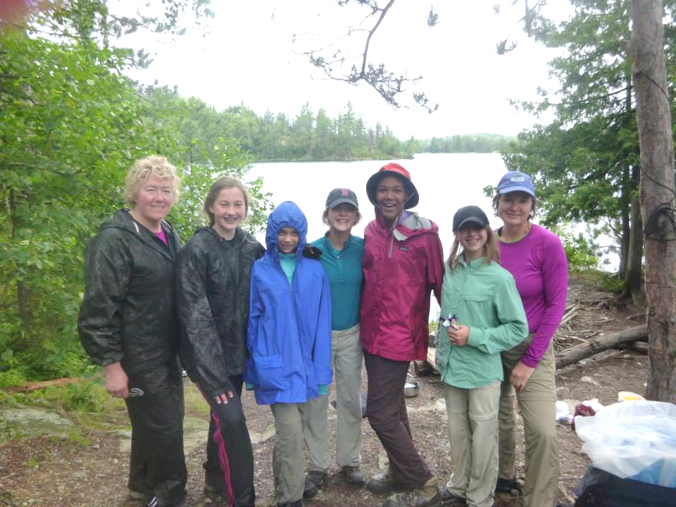
Standard Trips
Scheduled by Girl Scouts Lake and Pines and advertised in our camp guide
Ranging from a “Get Your Feet Wet” session (3 days in the woods) to an “Old Pro” session (10 days in the woods)
We also offer a “Women in the Wilderness” session
Check our camp guide in the spring at https://www.girlscoutslp.org/en/members/for-girl-scouts/camp-and-outdoors.html to find trip offerings

Slide 52
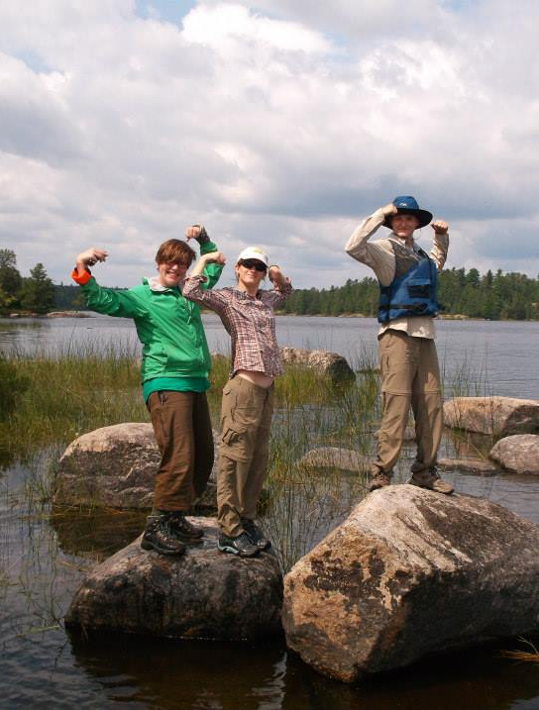
Flex Trips
Flexible scheduling
Organize your own group and chaperones
Apply in November for your preferred dates
Join our mailing list at http://nlcbaa.org to learn when flex trip sign ups are due each fall

Slide 53
I’m bringing a crew! FAQ
How and when do I get to Ely?
Where can we stay beforehand?
How many people can I bring?
Can adults come?
What kind of gear do we need?
How much does it cost?
What other activities or sites should we see in the region?

Slide 54
How do I get to Ely, Minnesota?
Ely is well-served by good roads and three airports within reasonable driving distance.
Hibbing (HIB): 85 miles or
about 1.5-2 hrs to Girl Scout Base
Duluth (DLH): 125 miles or about
2.5 hrs to Girl Scout Base
Chicago, IL: 600 miles or about 10.5 hrs to
Girl Scout Base
Minneapolis/St Paul (MSP): 265 miles or about 4.5-5 hours to Girl Scout Base

Slide 55
When do I arrive?
Meet Canoe Base staff at the Forest Service Building in Ely at 1:00 pm on your arrival day to caravan to the canoe base, about 20 minutes east of town.
1393 Hwy 169
Ely, Mn 55731
Many crews drive up from Duluth or Minneapolis / St. Paul on this day.

Slide 56
What is the Janette Pollay house and how can we use it?
Large two-story, Girl Scout cabin in Duluth
It is a perfect distance from the canoe base to use either the night before or after your trip, about 2-2.5 hours.
There are mattresses to sleep on and a kitchen to cook in.
About $50/night, per crew... cheaper than a hotel; easier than a campground.

Slide 57
How many people can come?
Typically, a full crew has at least 5 girl and/or adult participants.
If you have fewer, not to worry! We can combine you with other participants.
If you have more than 8 people, we will work with you to split into two or more groups.
Some groups have enjoyed having parents and leaders in one group and girls in another!

Slide 58
Your Girl Scout Crew
BWCAW regulations limit groups in the Boundary Waters to 9 people.
That means 5-8 of YOU and 1-2 wilderness canoe guides from the Northern Lakes Girl Scout Canoe Base.

Slide 59
Can adults come? What qualifications do they need?
Yes, adults are welcome, though a leader is not required, since the Canoe Base provides guides.
No, adults don’t need special qualifications -- they just need to be supportive of the girls and want to have fun, too!

Slide 60
What kind of gear does the NLCB provide?
Tents
Canoes
PFDs (lifejackets)
Paddles
Packs to carry personal and group gear
Cups, bowls and eating utensils for all
Cooking gear
Tasty food!
Kitchen rain fly
First aid kit

Slide 61
What kind of gear should participants bring?
Sleeping bag
Rain jacket and pants
Light hiking boots
Sneakers/Tennis shoes
Fleece or wool sweater
Warm hat
Water bottle
Personal clothing
A detailed packing list will be sent upon registration. We also have a video that gives you lots of details and options.

Slide 62
What kind of food will we eat?
Many of the same foods you
enjoy at home! You may eat:
Tacos
Pasta and sauce
Fresh fruits and veggies
Macaroni and cheese
Peanut butter and jelly
Pancakes
Dietary restrictions are no trouble.

Slide 63
How much does a Flex Trip cost?
For 2024, the cost is ~$75/day/person.
Remember, this includes awesome food, durable equipment, permits, and fun and safe leadership!
Our current prices are listed on our website at https://nlcbaa.org/summer.

Slide 64
The town of Ely, MN
Zups, Northland Market (grocery stores) or Shopko (pharmacy and department store) can provide you with last minute supplies like batteries and sunscreen
Many outfitters sell outdoor gear and souvenirs
Home to Ely-Bloomenson
Community Hospital providing
24-hr Emergency care

Slide 65
The town of Ely, MN
Many restaurants, including staff favorites, The Chocolate Moose and Dairy Queen; see the Ely Chamber of Commerce for details
http://www.ely.org/dining-shopping/dining/restaurants

Slide 66
What should we see in Ely?
Ely is home to the International Wolf Center and North American Bear Center, where you can see the animals live.
The Dorothy Molter Museum shares the history of one of the last residents of the BWCAW, “The Rootbeer Lady.”
The Ely Chamber of Commerce lists these and other attractions that may be of interest.

Slide 67
What else should we see in Northern Minnesota?
The North Shore of Lake Superior has many beautiful natural areas and waterfalls, and is also home to the Split Rock Lighthouse.

Slide 68
What else should we see in Northern Minnesota?
The Bois Forte Ojibwe Heritage Museum is in nearby Tower, MN
Duluth has lots to explore with the waterfront on Lake Superior, shopping, and an aquarium and a zoo.

Slide 69
What else should we see in Northern Minnesota?
Go explore beneath the earth’s surface at Soudan Underground Mine State Park or learn more about past and present mining at the Minnesota Discovery Center.
Canoe Base Guides and Guides-in-Training take a tour of the Soudan Underground Mine on a day off.

Slide 70
Let’s do this.
Apply for our Destination.
And check out our camp guide in the spring at https://www.girlscoutslp.org/en/members/for-girl-scouts/camp-and-outdoors.html to join a standard trip.
Join our mailing list at http://nlcbaa.org to learn when flex trip sign ups are due each fall.

Slide 71
See You in the Northwoods!

